Slide 1
Know your target audience (delete this slide before presenting)
Public health professionals
Health providers
School staff
Parents
NOT youth

Slide 2
Brand as your own (delete this slide before presenting)
Notes:
These slides are plain – feel free to add the content to your branded templates and add your logo.

Slide 3
Notes are provided (delete this slide before presenting)

Slide 4
Youth E-cigarette Use – A New Generation at Risk

Slide 5
E-cigarettes or vapes come in all shapes and sizes.
Notes:
E-cigarettes are battery-powered devices that allow users to inhale, or vape, aerosolized liquid (e-juice). E-cigarettes, “vapes”, vape or hookah pens, e-pipes, and other vaping products like JUUL (pictured third from the right) recently surpassed conventional cigarettes as the most commonly used tobacco product among youth so it is critical that public health officials and the general public understand the potential risks of using them.
And just to note, e-cigarettes are not FDA approved for tobacco cessation, despite any claims that they might help a person quit.

Slide 6
A youth epidemic.
A 68 percent increase between 2014 and 2016
Wisconsin Youth Tobacco Survey
Notes:
Youth e-cigarette use is a public health threat. The FDA has called it an epidemic.
Since 2014, e-cigarettes use has increased by 68 percent among Wisconsin high school students.
Additionally, Nearly half of e-cigarette users in Wisconsin also smoke cigarettes.

Slide 7
Nicotine harms brain development as teens grow.
Youth nicotine exposure has negative implications for learning, memory, and attention span.
Vector illustration credit: Vecteezy
Notes:
This is concerning as nearly all e-cigarettes contain nicotine, which we know is highly addictive. Nicotine exposure can also harm the developing adolescent brain. Because the brain is still developing until about age 25, youth and young adult exposure to nicotine can lead to addiction and disrupt attention and learning. No amount of nicotine is safe for youth.

Slide 8
The brain learns addiction.
Nicotine can change brain chemistry, making youth more susceptible to addiction.
The earlier the exposure, the greater the risk.
Vector illustration credit: Vecteezy
Notes:
Nicotine primes the adolescent brain for addiction.
Because their brains are still developing, adolescents can become addicted to nicotine more easily than adults. Nicotine can change brain chemistry, making youth more susceptible to addiction. And the earlier the exposure, the greater the risk.

Slide 9
Nicotine addiction can happen quickly.
Symptoms of nicotine addiction can appear among youth within only a few days or weeks after smoking initiation.
DiFranza et al., 2000, Tobacco Control; Surgeon General’s Report, 1988, 2014
Notes:
Nicotine is a highly addictive drug. Studies show that symptoms of nicotine addiction can appear among youth within only a few days or weeks after smoking initiation.

Slide 10
Increased risk of addiction to tobacco, drugs and alcohol.
Vector illustration credit: Vecteezy
Notes:
Youth exposed to nicotine are more likely to use other substances.
Receptors in the brain are stimulated by exposure to nicotine, which triggers a rewarding effect on the brain. These receptors respond to and enhance the effects of nicotine and other drugs. The more adolescents are exposed to nicotine, the greater the sense of enjoyment because the effects of nicotine and other drugs are made stronger by repeated exposure. This effect increases the likelihood that youth will develop a dependence on those drugs.

Slide 11
Kids who vape are…
2x
more likely to smoke
Watkins et al., 2018, JAMA
Notes:
Recent evidence suggests that, compared to youth who have never used them, youth who have tried e-cigarettes are twice as likely to start smoking in the future.

Slide 12
New technologies reveal new risks.
High concentration of nicotine
Nicotine salt technology allows for quicker absorption into the lungs and brain
Fruit and other flavors
Notes:
They come in all shapes and sizes, and a specific product called JUUL looks like a USB or flash drive. These products are easily hidden, emit limited odor, and the aerosol dissipates quickly.
E-cigarettes are also available in fruit and candy flavors; flavored tobacco products appeal to youth.
JUUL pods, which come in fruit and other flavors, and we know flavored tobacco products appeal to youth. They also contain the same amount of nicotine as a pack of cigarettes. These new products use nicotine salts, which goes more directly to the brain.
JUUL pods have 59 mg/ml of nicotine at 5% strength. This is the highest level of nicotine on the e-cigarette market. In fact, unlike your average e-cigarette, JUUL devices deliver nicotine at levels that mimic cigarettes.
Sales of JUUL grew more than seven-fold from 2016-2017 and was the most commonly sold e-cigarette in the US in 2017.

Slide 13
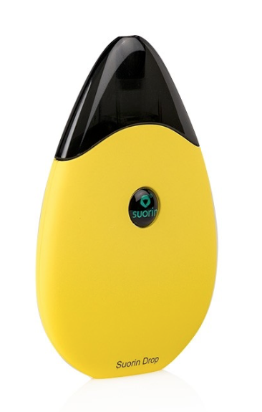
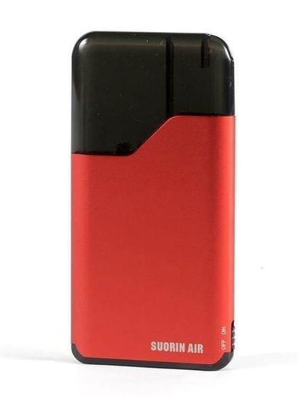
New technologies reveal new risks.
Suorin
Popular open-pod system e-cigarette.
Drop
Air
Users buy device and add any e-liquid.
Discrete and easy to use (smaller than a credit card)
Notes:
Suorin (pronounced Sore-in) is an e-cigarette that’s quickly gaining in popularity, especially among youth.
Suorin’s most popular devices include the Drop and the Air (both pictured).
Both the Drop and the Air are smaller than a credit card and can easily be concealed in the palm of the hand, making it difficult to detect.
What makes the Suorin Drop and Air different than e-cigarettes like JUUL, is these products are an open pod system. Open pod systems are sold without nicotine e-liquid. This allows the user to fill and refill the device with any e-liquid available to them.

Slide 14
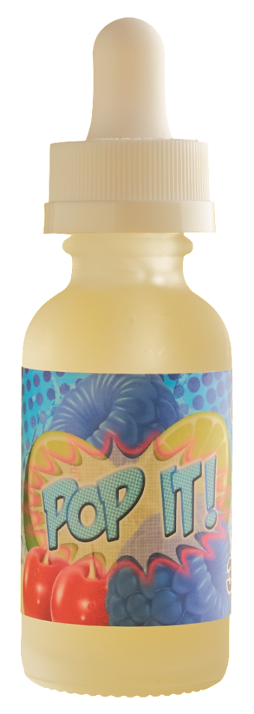
Flavors attract new users
88%
of Wisconsin high school students say they wouldn’t try an e-cigarette if it didn’t come in flavors like mint, candy, fruit, or chocolate.
Notes:
88% of Wisconsin high school students say they wouldn’t try an e-cigarette if it wasn’t flavored like mint, candy, fruit, or chocolate.
8 out of 10 kids who’ve used tobacco tried a flavored product first.
More than 15,500 unique e-cigarette flavors are available online. (Zhu, S-H, et al., “Evolution of Electronic Cigarette Brands from 2013-2014 to 2016-2017: Analysis of Brand Websites,” Journal of Medical Internet Research, 20(3), published online March 12, 2018.)
Personalize by discussing some of the craziest flavors you’ve seen and asking that question of your audience.

Slide 15
Flavors and packaging
Tips to talk to your kids
Types of e-cigarettes and risks
Learn more at tobaccoischanging.com
Notes:
Learn about the different types of e-cigarettes and the risk they pose for youth.
Learn more about issues like the flavoring and packaging of e-cigarettes and other tobacco products.
Gets tips to talk to your kids about the risks of e-cigarettes and other tobacco products.

Slide 16
Recommendations for School Staff
Learn about the different types of e-cigarettes and the risk they pose for youth.
Change curriculum to be inclusive of e-cigarettes and other tobacco products.
Develop, implement, and enforce comprehensive tobacco-free school policies.
Contact your local coalition (Insert URL, Logo, etc.)
Notes:
Learn about the different types of e-cigarettes the risk they pose for youth.
Change curriculum to be inclusive of e-cigarettes and other tobacco products.
Develop, implement, and enforce comprehensive tobacco-free school policies.

Slide 17
Insert your contact information
Notes:
Encourage the audience to follow up with you for more information or to get involved.

