Slide 1
Populations that stand out from the crowd
Tobacco’s disproportionate burden
Presenter Name
Presenter Agency
Date
Your logo here (or delete this box)
Notes:
Presenter notes:
These notes are provided as a guide. Feel free to make this your own. Add or remove slides as needed; select about 2-3 populations to talk about and include local context either in local population or partnership organizations (slides 4-13). Add local context by talking about local efforts that are occurring around those disparities, organizations the coalition is working with that serve those populations, etc.
After the presentation, the audience can receive copies of the stat shot to take with. It is recommended to not print PowerPoint slides as handouts.
Pare down or expound on your local efforts as needed. This is your presentation!
We have put text in red that needs to be tailored to your community. Please change the text color to gray or something complementary before you present.

Slide 2
Key definitions
Health disparities
Population-based differences
Health inequity
Differences caused by systematic and social conditions
Healthiest People 2020
Assessment Related to Racial Equity 2014
Notes:
Presenters note: Talk through the difference of health disparities and health inequities. In context, disparities show the difference, in this particular case it is specific to what the data shows, whereas inequities refer to the root cause of disparities. To decrease the disparity gap, health inequities need to be addressed.
A visual that shows the difference between health equality and health equity:
https://s-media-cache-ak0.pinimg.com/originals/d7/3d/06/d73d06e297a8d90ce7eb6a9312059ec6.jpg
For more information:
Healthy People 2020. Retrieved from https://www.healthypeople.gov/2020/about/foundation-health-measures/Disparities
Eliminating Disparities in Child and Youth Success Collaborative (2014).
Tool for Organizational Self
-
Assessment Related to Racial Equity. Retrieved from http://coalitioncommunitiescolor.org/wp-content/uploads/2014/06/Tool-for-Organizational-Self-Assessment-Related-to-Racial-Equity-2014.pdf

Slide 3
The data tells the stories
Notes:
Presenter note: The data tells a story and highlights populations and communities that are impacted more than others. We are committed to focusing efforts and resources in an equitable way (providing more resources and attention to populations who are disproportionately impacted) to lessen the tobacco-related disparity gap that exists.
You can use both slides 2&3 or just one of the slides depending on what works for your presentation.
Explain that this data is pulled from either Wisconsin specifically or is national data, and that you are sharing just a few of the available stats (and general population rate numbers might vary based on state or national data and year(s) data was collected. Refer to the slide’s citation to determine if it’s state or national.

Slide 4
70%-80% of homeless adults smoke in the United States
Lee TC, Hanlon JG, Ben-David J, et al. Risk factors for cardiovascular disease in homeless adults. Circulation. 2005;111:2629–35
Notes:
Slides 4-14 highlight data for specific populations. Use the slides that apply to the 2-3 populations you are focusing on for your presentation. Add local context by talking about local efforts that are occurring around those disparities, organizations the coalition is working with that serve those populations, etc.

Slide 5
1 out of 3 smokers in the US military started after enlisting
2009 Institute of Medicine

Slide 6
LGB communities smoke more than heterosexual communities
High School: YRBS, 2014
Adults: BRFSS, 2015
Notes:
Presenter notes: LGB = Lesbian, Gay, Bisexual
You can note that there is often not data collected on the transgender community (which is why this only says LGB and is missing the “T”), and if there is it has only recently started and sample sizes are too small to share reliable data. If people ask why…you can say for a variety of reasons (but point out that it is hypothesized that individuals who identify as transgender are even more disproportionately impacted by the burden of tobacco than their LGB peers)

Slide 7
138,000 respondents (2009-2011 US adults)
20% (n= 27,600) have a mental illness
Individuals with a mental illness smoke a third of all cigarettes
33% (n=9,108) adults with a mental illness smoke
Centers for Disease Control and Prevention. Vital Signs: Current Cigarette Smoking Among Adults Aged ≥18 Years with Mental Illness—United States, 2009–2011.
Notes:
Presenter note: There is animation on this slide, practice running through before presenting.
There was a survey done in the United States covering 2009-2011, and included 138,000 respondents.
This found that –CLICK--
20% of adults in the United States have a mental illness
--CLICK--
A third of these adults with a mental illness smoke
--CLICK—
And a third of all cigarettes are smoked by individuals with mental illness
Methods information:
Combined data from the 2009–2011 National Survey on Drug Use and Health (NSDUH) were used to calculate national and state estimates of cigarette smoking among adults aged ≥18 years who had any mental illness (AMI), defined as having a mental, behavioral, or emotional disorder, excluding developmental and substance use disorders, in the past 12 months.

Slide 8
77-93% of individuals in treatment for substance abuse addiction smoke These individuals are more likely to die from their tobacco use than their drug addiction
Richter KP, Arnsten JH. A rationale and model for addressing tobacco dependence in substance abuse treatment. Substance Abuse Treatment, Prevention, and Policy. 2006;1:23.

Slide 9
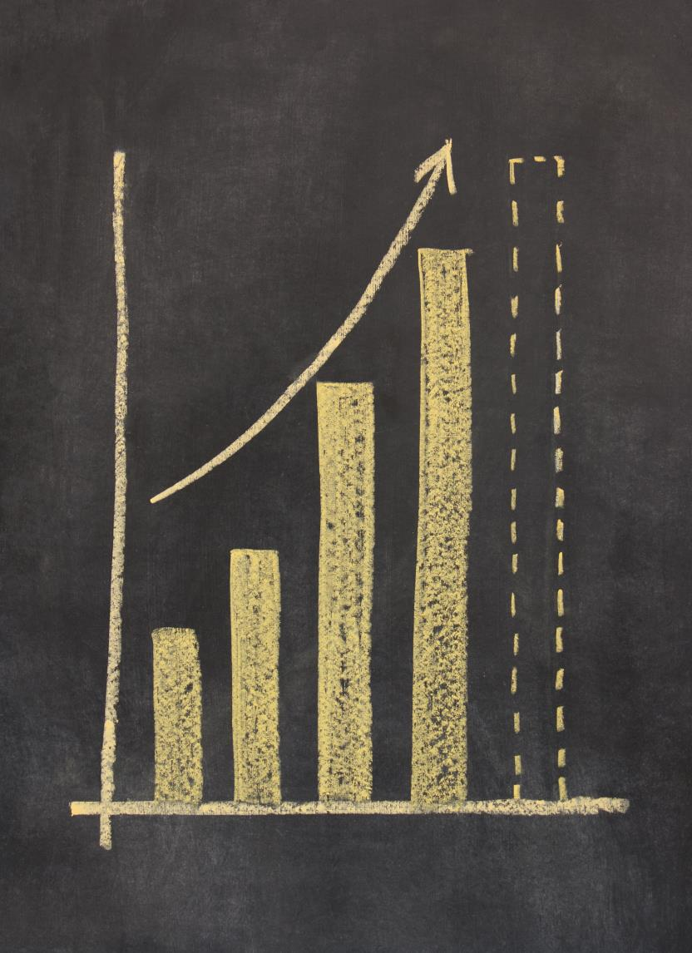
Research shows that when individuals quit tobacco and other substances at the same time, they are 25% more likely to stay off both.
Prochaska, JJ et al. A Meta-Analysis of Smoking Cessation Interventions with Individuals in Substance Abuse Treatment or Recovery. Journal of Consulting and Clinical Psychology. 2004;72(6)

Slide 10
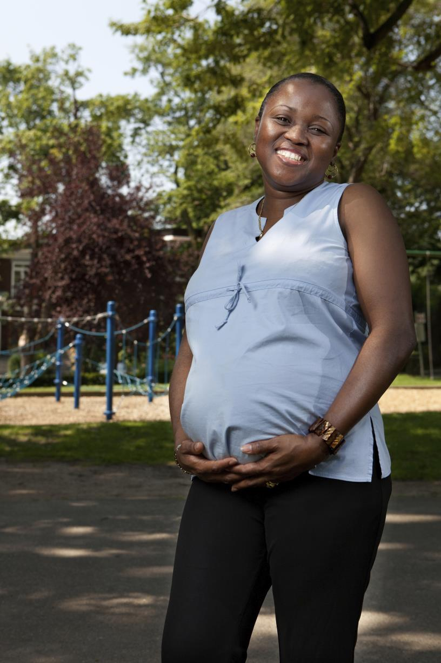
Wisconsin pregnant women smoke more than the national average
WI
US
2011 Pregnancy Risk Assessment and Monitoring System

Slide 11
Racial/ethnic populations are impacted differently
19% WI Average
2011-2015 Wisconsin Behavioral Risk Factor Surveillance System
Notes:
Presenter note: Populations are impacted differently. You can call out that African Americans are unique in Wisconsin, smoking at twice the rate as the national African American numbers.
These numbers merge several years so the Wisconsin average is a little higher than most recent data. Data needs to be merged to ensure quality data of certain demographic populations.

Slide 12
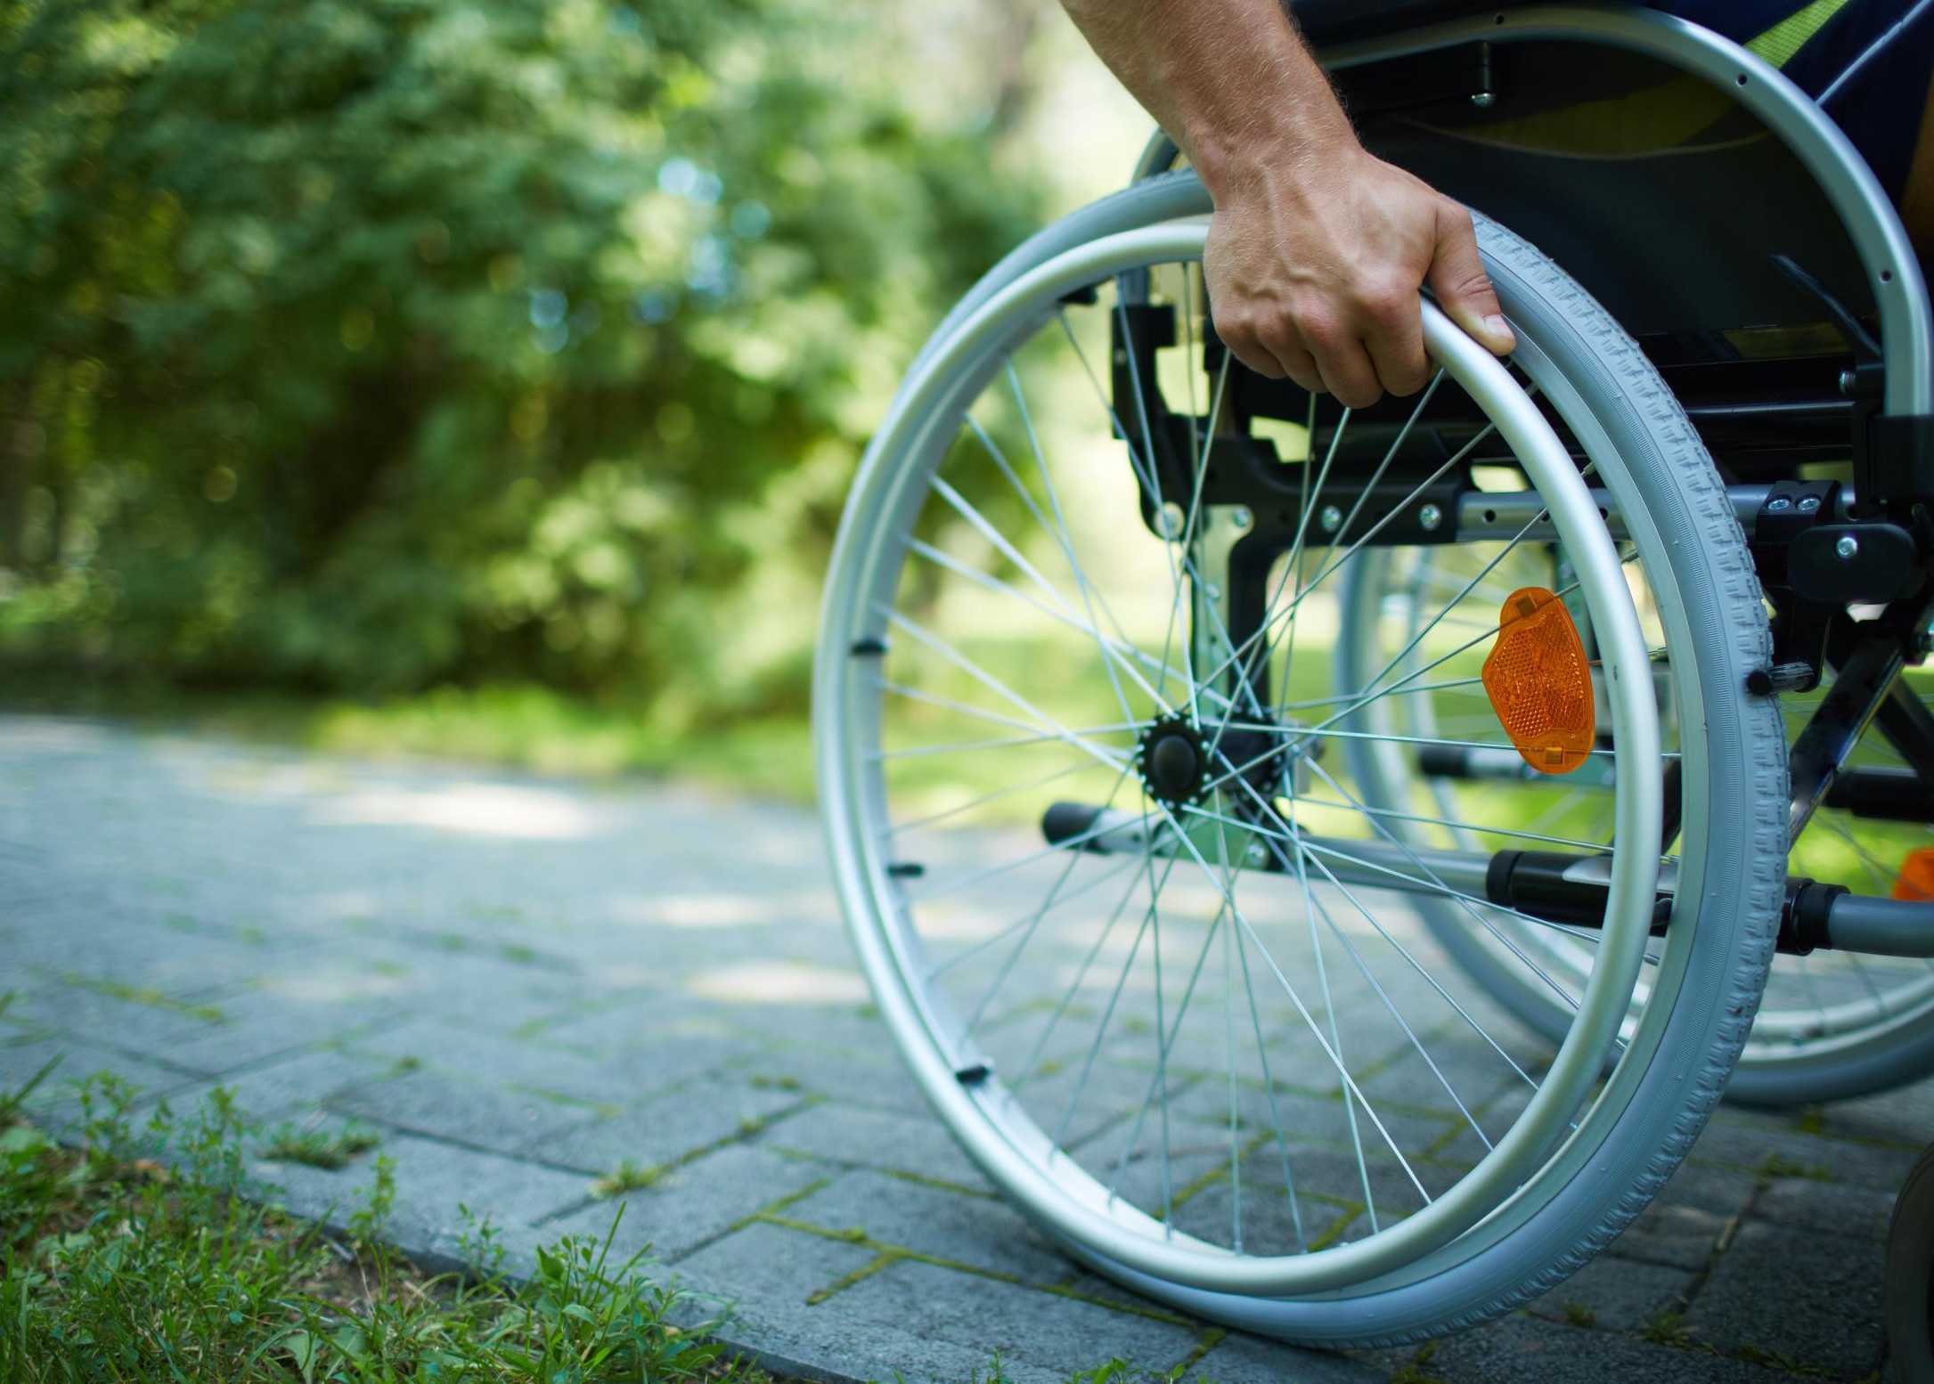
Nationally, adults with disabilities smoke more than people without disabilities
Disability
No Disability
CDC, MMWR 2014; 63(47):1108-12

Slide 13
Individuals with less education smoke more than other populations
18% WI average
2014 Wisconsin Behavioral Risk Factor Surveillance System
Notes:
Presenter note: This is 2014 data, so the Wisconsin average is from that particular year

Slide 14
Individuals with lower-incomes smoke at nearly 3x the rate of those with higher-incomes
18% WI average
Adults: BRFSS, 2014
Notes:
Presenter note: This is 2014 data, so the Wisconsin average is from that particular year

Slide 15
Notes:
Presenter note: At this point, you are transitioning to talk about potential solutions and partnerships. What do you want to ask of this group (for example, ideas for solutions, a seat at the table, an invitation for them to join your existing efforts, monetary support)? Insert more slides as needed.
You could lead a discussion about what strategies people are interested in or might be already doing.

Slide 16
Thank you!
Tobacco’s disproportionate burden
Presenter Name
Presenter Agency
Date
Your logo here (or delete this box)
Notes:
Thank you so much for your attention and input! What questions do you have?
Presenter note: We have put text in red that needs to be tailored to your community. Please change the text color to gray or something complementary before you present.

