Slide 1
Karen Doster
Wisconsin Tobacco Prevention and Control Program
Karen.Doster @dhs.wisconsin.gov
608-267-6768
www.wismokefreehousing.com
Notes:
We have known for a while now that smoking is harmful to the smoker’s health, but it is also harmful to your business’s bottom line.
Enacting a smoke-free policy in the housing you manage or own can save you money.

Slide 2
Clear Gains Vision
Smoke-free housing is available to all Wisconsin residents
www.wismokefreehousing.com
Notes:
Clear Gains is WI smoke free housing initiative. Our vision is that SF housing will be available to all WI residents.
To make that vision a reality, we work together with our partners from around the state to inform property owners about the business and health benefits of smoke-free policies.
If owners want to go smoke free , we assist them with this process.
We want everyone to enjoy the benefits of SF housing

Slide 3
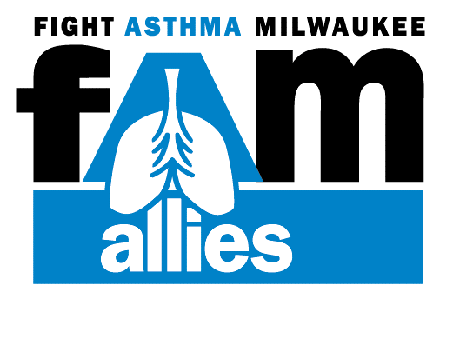
Clear Gains Network Partners
www.wismokefreehousing.com
Notes:
The Clear Gains Network is a collection of statewide organizations that provides support and guidance to Wisconsin's smoke-free housing initiative.
The Network's vision is a Wisconsin where smoke-free housing is available to all.
To make that vision a reality, the Clear Gains Network informs Wisconsin property owners about the business and health benefits of smoke-free policies in multi-family dwellings and provides resources for making residential properties smoke-free.

Slide 4
Smoke-Free Housing: A Billowing Trend
www.wismokefreehousing.com
Notes:
In June of last year, Related Companies became the first developer and owner to implement a nationwide smoke-free policy for all of its rental properties. This is over 40,000 units.
This trend is occurring in WI too. Millennium Housing Foundation has 15 properties throughout Wisconsin and they provide safe affordable housing to those with moderate to low incomes. All of their units are now smoke free.
Three sixty has 4 buildings, 78 units that are now SF
Ripple just went smoke free. They have a combination of multi unit, duplexes and SFH that are now SF representing 600 units.

Slide 5
74 Housing Authorities are Smoke-free
www.wismokefreehousing.com
Notes:
This trend is not just happening in private housing. Last September, Boston Housing Authority , which is one of the largest public housing authorities in the Nation, adopted a smoke-free policy for 100% of their properties. This provides its 25, 000 tenants a smoke-free living environment.
Recent data shows that there are 127 Public Housing Authorities in the State of Wisconsin. 74 of these have implemented smokefree policies including at least one of their buildings. As recently mandated by HUD, the rest must do so by July 31, 2018. – But we will get to that later.
(update as needed) Most recently, Monroe Housing Authority went smoke free in December of 2016 and the Dane Co. Housing Authority and Community Development Authority-Madison HA, have just started their implementation process with an effective date of January 1, 2018!

Slide 6
Profitable
Popular
Legal
Healthy
Easy
www.wismokefreehousing.com

Slide 7
Smoke Damaged Unit
Tenant rented this unit for 14 years smoking 3 packs/day
www.wismokefreehousing.com

Slide 8
$2740 +
www.wismokefreehousing.com
Notes:
It can cost up to 6 times more to clean an apt that has been smoked in compared to one that hasn’t.
It can take more labor and paint – costing you more in the end.
If you use this example, that means a cost savings of over $2500 per unit.
It’s estimated by owners it can cost $500 to $8000 more to rehab an apartment that a smoker lived in compared to a non-smoker.
Turnover time can also take longer – that is hundreds of dollars that you could be losing because of smoking.
A smoke-free policy means lower cleaning and renovation costs, a quicker turnover, both resulting in an economic benefit for you.
Cite: See reference on Clear Gains in Smoke-Free Housing

Slide 9
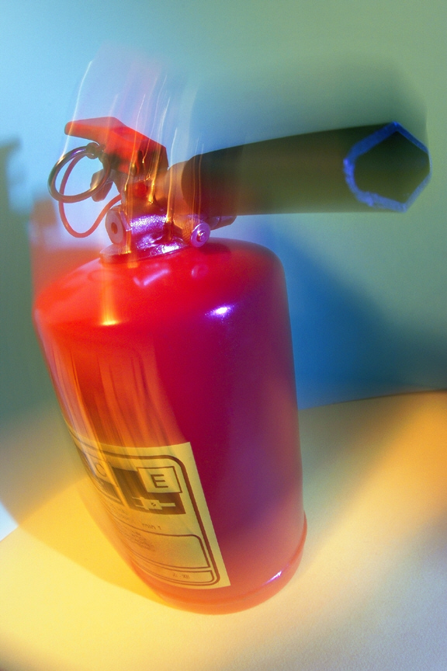
Less Risk of Fire Damage
www.wismokefreehousing.com
Notes:
***Fire damage video hyperlinked to picture- https://www.youtube.com/watch?v=CYkEgzVoB7U&list=TLRW-UuqL4l4P8j4c-UI3iWvcvRHNv1eF6
A smoke-free policy means decreasing the risk of fire and the costs associated with fires.
Cigarette smoking is the leading cause of fires in multi-unit housing buildings. The cost of these fires average about $20,000 in loss per fire.
So, if someone falls asleep with a cigarette or doesn’t dispose of it properly, both your property and the lives of your tenants are at risk.
If a fire occurs, the damage will need to be repaired in the smokers unit, and likely other units as well. Tenants may have to relocate while the units are being repaired. If they relocate, then might not return, another financial loss.
[If there have been any local stories in the news about smoking caused fires, reference here]
Cite: See reference on Clear Gains in Smoke-Free Housing

Slide 10
www.wismokefreehousing.com
Notes:
Without the risk of smoking related fires, you may see your insurance premiums go down.
On the flip side, you may not see your premiums rise, because you wont have the expensive claims associated with smoking related fires.
Either way it is a cost savings to you.
(Currently WI does not have a tax break for sf policies- some states do)
(what states have seen decreased insurance rates,
Maine, California and New Hampshire offer tax credits incentives for new housing projects that offer no-smoking policies.

Slide 11
Profitable
Popular
Legal
Healthy
Easy
www.wismokefreehousing.com

Slide 12
www.wismokefreehousing.com
Notes:
People want smoke-free housing.
According to the CDC only 15% of the population currently smoke and this number is decreasing.
Current smoking has declined from nearly 21 of every 100 adults in 2005 to about 15 of every 100 adults in 2015.
A survey of WI residents shows that 70% of renters in buildings that allow smoking, but keep their units smoke free, would prefer non-smoking buildings”.
A renter’s survey from Minnesota showed that “Of renters who are exposed to secondhand smoke, 34% are so bothered by the smoke that they are thinking of moving in order to avoid exposure.
When asked, 75% for renters responded that they would be likely to choose a smoke-free building over a building that allows smoking if the buildings were the same in every other way.
So, a smoke-free policy is an unique amenity that you can offer to your tenants.
Cite: See reference on Clear Gains in Smoke-Free Housing

Slide 13
“There is no safe level of exposure to secondhand smoke.
Any exposure is harmful.”
- US Surgeon General
www.wismokefreehousing.com
Notes:
According to a Wisconsin survey, by the center for Urban Initiatives and Research,
54% of renters in apartment buildings that allow smoking are concerned about the health effects of secondhand smoke from other units.
And they should be. The US Surgeon General has said, “There is no safe level of exposure to secondhand smoke.
Any exposure, even small amounts, can be harmful.
Secondhand smoke has been classified as a carcinogen which can lead to lung cancer. It can also cause an increased risk of heart attacks and exacerbate asthma and other lung diseases, as well as other health problems.
There is no safe level of exposure to secondhand smoke.

Slide 14
Recycled Air in Apartments
Up to 60%
www.wismokefreehousing.com
Notes:
Air in apartment buildings is recycled between units.
Air quality studies that have looked at the flow of air between units show that up to 60% of the air in apartment units comes from other units in the building.
Therefore, the chemicals and carcinogens that are in secondhand smoke find their way into all of the units in the building.
Cite: Secondhand smoke transfer in multiunit housing. Nicotine and Tobacco Research 2010; 12:1133-41.
Ventilation and infiltration in high-rise apartment buildings. Lawrence Berkeley Laboratory Report, LBL-38103, Berkeley, California, 1996.

Slide 15
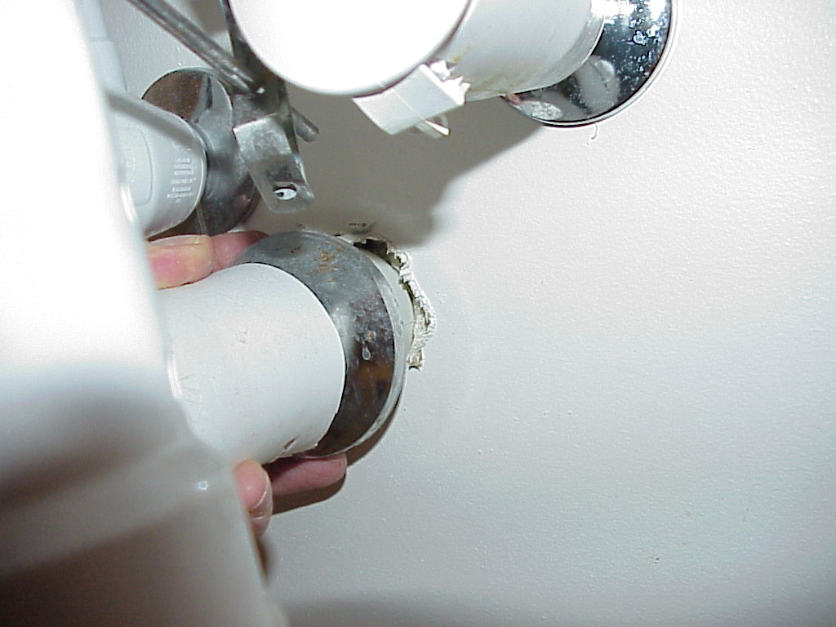
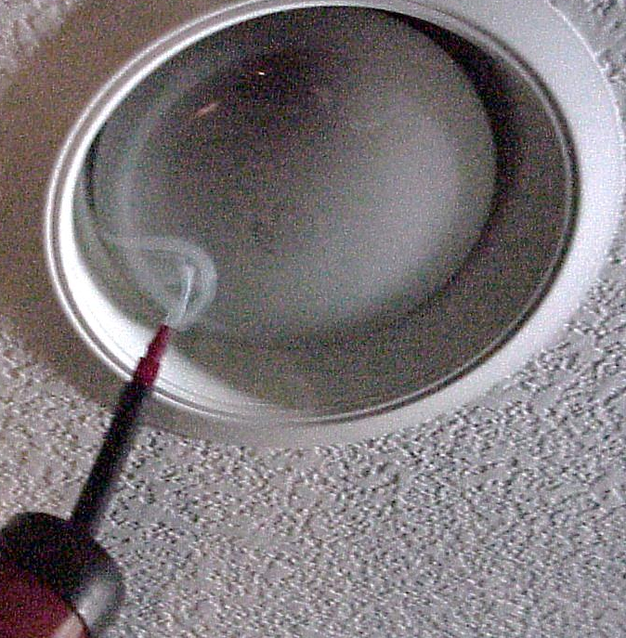
Notes:
Secondhand smoke can travel through gaps along baseboards, electrical outlets, shared heating and ventilation systems, through light fixtures, and in and out of doorways and windows. The path smoke takes through buildings is hard to predict and difficult if not impossible to stop.
Smoke travels through tiny cracks and crevices, involuntarily exposing individuals in adjacent units.
Cite: Center for Energy and Environment

Slide 16
Ventilation Doesn’t Help
“The only means of effectively eliminating health risk associated with indoor exposure is to ban smoking activity.”
www.wismokefreehousing.com
Notes:
Ventilation is not a solution.
Most air filter systems are designed to remove odors, not the toxic particles from tobacco smoke.
The American Society of Heating, Refrigerating and Air-Conditioning Engineers –( the governing agency that sets the standard for indoor air quality)
has said “the only means of effectively eliminating health risk associated with indoor exposure to secondhand smoke is to ban smoking activity.
This group does their best to clean the air we breathe but even they are saying that ventilation systems are unable to protect building occupants for secondhand smoke.”
The current technology is unable to eliminate the harmful chemicals from the air that we breathe.
Cite: 2010 ASHRAE Position Document on Environmental Tobacco Smoke

Slide 17
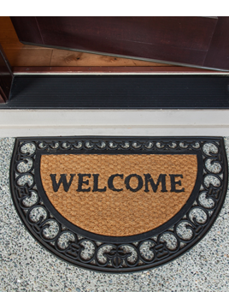
Will a smoke-free policy affect my occupancy rate?
www.wismokefreehousing.com
Notes:
Property owners/managers have verbally reported:
No noticeable differences in vacancy rates
Tenants are asking about SF policies
Tenants have looked elsewhere when SF polices are not in place
Restaurants and bars have not seen a decrease in revenue, many have seen an increase.
(Talk about resident survey and ask them to complete)

Slide 18
Profitable
Popular
Legal
Healthy
Easy
www.wismokefreehousing.com

Slide 19
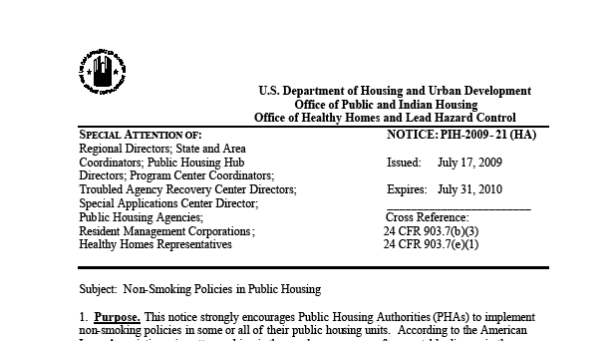
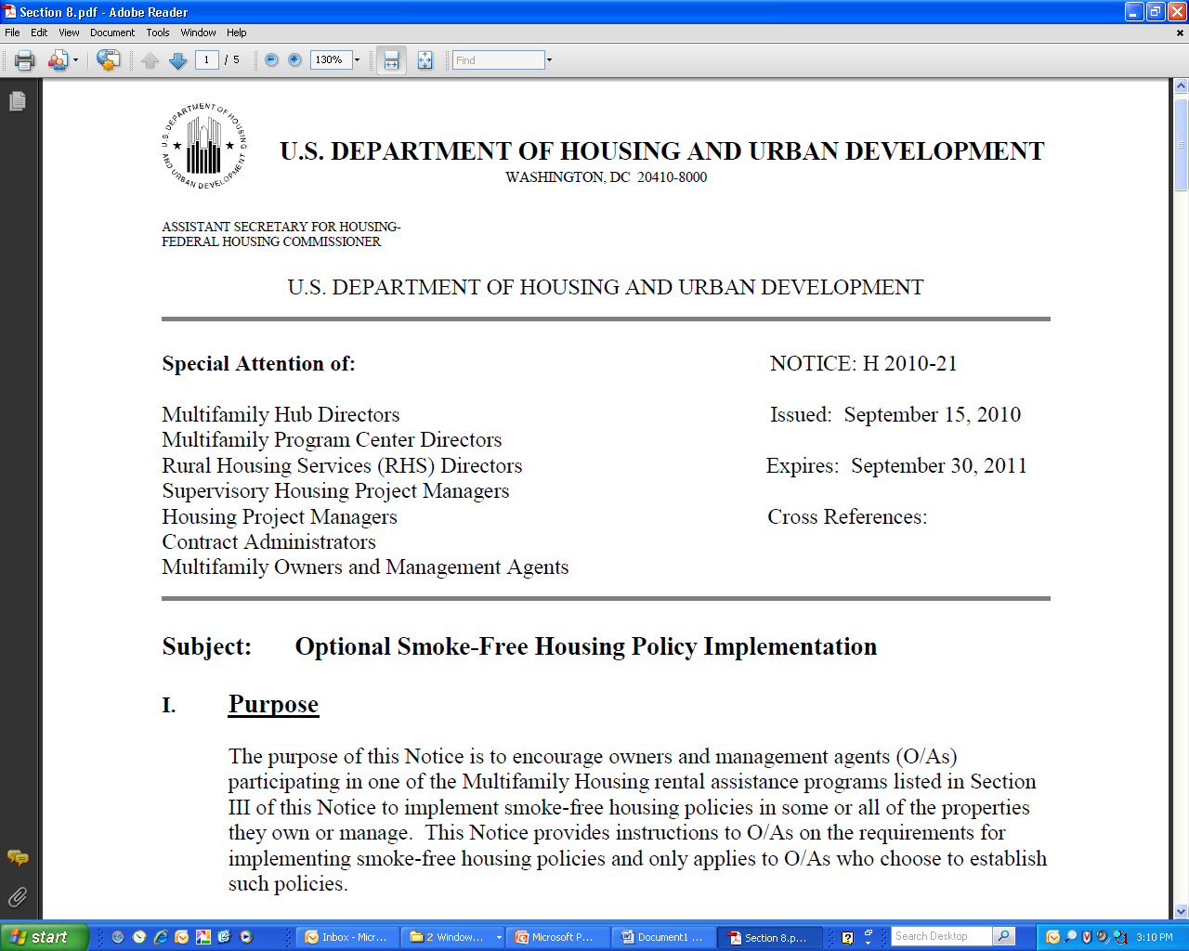
Private Housing
Notes:
Legally- SF is the way things are starting to lean
In 2010 WI passed a statewide smoke-free air law which prohibits smoking in public/ common areas
There is no legally recognized “right to smoke”
For private housing there are no federal laws that prevent owners and managers from adopting SF policies for their properties. Adopting a no smoking policy is no different than having a no pets policy.
Most new construction buildings are no smoking or have never allowed smoking to begin with

Slide 20
Public Housing Mandate
www.wismokefreehousing.com
Notes:
On November 30, 2016 HUD (Housing and Urban Development) announced that public housing developments in the US will be REQUIRED to go smoke-free.
The rule finalized in February of 2017 and allows 18 months for housing authorities to go smoke-free.
Nationally over 3000 public housing agencies will be implementing a smokefree policy by July 2018.
This rule prohibits the use of cigarettes, cigars, pipes and hookahs in all living units, indoor common areas, administrative offices and outdoor areas within 25 ft. from the buildings.
The rule does not cover, mixed finance development, section 8 housing or electronic cigarettes.
Housing authorities have the right to further restrictions as they see necessary (including e-cigs, property-wide smoke free policy, restrict smoking in certain areas, etc.)

Slide 21
Smoke-free Public Housing
Reduce tobacco use
Reduce secondhand smoke exposure
Save money
Notes:
Improve the health of very low-income tenants by reducing secondhand smoke exposure
Reduce tobacco use among low-income smokers if policies are combined with treatment
Save over $15 million dollars/year in maintenance costs
Save about $500 million dollars/year in health care costs
Over 700,000 units would be affected by this rule (including over 500,000 units inhabited by elderly households or households with a non-elderly person with disabilities)
There are also over 775,000 children in these units.

Slide 22
Smoke-free Public Housing
Build relationships
Education
Connect
Notes:
Clear Gains and coalitions throughout the state are helping housing authorities
List the ways you can partner with housing authorities

Slide 23
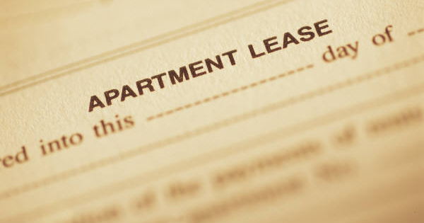
www.wismokefreehousing.com
Notes:
If you decide to adopt a smoke-free policy, you need to let your tenants know about it. This is done by adding the smoke-free policy to the apartment lease.
Lease provisions
Definition of “smoking”
E-cigarettes
Description of where smoking is prohibited
Individual units, patios,
entrances, entire property
Enforcement process for policy violation
Verbal warning, written warning, eviction

Slide 24
How do I ensure compliance?
Engage residents
Provide notice
Post signs
Market the property as smoke-free
Enforcement
www.wismokefreehousing.com
Notes:
Provide plenty of notice
-Set a smoke-free date
-provide residents with a notification letter
-sign a smoke-free lease addendum
-new residents sign smoke-free policy or addendum.
Post signs
-Post signs to show that smoking is not allowed in the various areas
-remove any smoking containers
-enforcement – outline your enforcement procedure – verbal warning, written warning, eviction
-use language like “you have chosen not to live here because you have chosen to not follow the rules”
-if someone choses to move – you may want to help them with relocation
Enforce your policy the same way you enforce other infractions (pets, noise)
Residents can be your greatest allies
Engage residents in the process
Actively market your property as non-smoking
Provide incentives to tenants to keep their apt looking great and use as a model apt when showing prospective tenants.
Property owners are discovering, as the bar and restaurant owners did, that smoke-free policies attract more new business than is lost due to adopting the smoke-free policy

Slide 25
Profitable
Popular
Legal
Healthy
Easy
www.wismokefreehousing.com

Slide 26
Health Benefits
www.wismokefreehousing.com
Notes:
***Laquita video hyperlinked to picture

Slide 27
What are the health benefits of quitting?
www.wismokefreehousing.com
Notes:
20 minutes: The heart rate and blood pressure drop back to normal levels
12 hours: The level of carbon monoxide in the blood drops back to normal
2 weeks: Circulation and lung function improve
1-9 weeks: Smoker “norms” ( like a constant cough, shortness of breath) become less pronounced. The tiny hairs lining the lungs (cilia) work normally again and clean the lungs to reduce risk of infection
1 year: The risk of getting coronary heart disease is half as high as a smokers
5 years: The risk of contracting mouth, throat, esophagus, and bladder cancers is half of what it is for smokers. Risk of cervical cancer and stroke fall, too
10 years: The risk of dying from lung cancer is half that of smokers. Risk of getting pancreatic and larynx cancer also decreases
15 years: The risk of heart disease is equivalent to non-smokers risk

Slide 28
The majority of persons with mental illness and substance use disorders want to quit smoking.
www.wismokefreehousing.com
Notes:
Persons with mental illness and substance abuse disorders can successfully quit using tobacco at rates similar to the general population.
Behavioral health facilities are:
Offering smoking cessation resources
Providing smoke-free living environments
Meta House- 100% smoke-free, 2012
Salvation Army – 100% smoke-free shelter, 2002
Smoke-free housing can:
Help smokers quit
Reduce the use of other addictive substances
Improve overall health

Slide 29
Profitable
Popular
Legal
Healthy
Easy
www.wismokefreehousing.com

Slide 30
Website Resources
www.wismokefreehousing.com
Notes:
On wismokefreehousing.com there are many resources that can answer specific questions you might have and tools to guide you through the implementation and enforcement process.

Slide 31
Smoke-Free Housing Finder
www.wismokefreehousing.com

Slide 32
Property Owner
“Going smoke free has been one of the best management decisions we have made, our residents are happier and as owners we are proud of our properties.”
Scott Olson
Grandview Pines Properties
www.wismokefreehousing.com

Slide 33
www.wismokefreehousing.com

Slide 34
Karen Doster
Wisconsin Tobacco Prevention and Control Program
Karen.Doster @dhs.wisconsin.gov
608-267-6768
www.wismokefreehousing.com
Notes:
There are clear gains to smoke-free housing – you can save money and have cleaner and safer buildings.

