Slide 1
Counter Tools – Wisconsin Retail Assessment Project
Data Collector Training

Slide 2
Agenda
Introduction to Data Collection Project
Why Point-of-Sale Matters
Why Do We Do Store Audits?
Store Assessment Form Overview
Tobacco Product Glossary
General Instructions & Store Etiquette
Five Steps to Being a Team Member
Worksheet Practice & Review
Wrap-up

Slide 3
Introduction to the data collection project

Slide 4
Introduction
Thank you for volunteering!
Project leader objective
Role of volunteers

Slide 5
Why Point-of-Sale Matters

Slide 6
4 Reasons Why POS Matters

Slide 7
Why Do We Do Store Assessments?

Slide 8
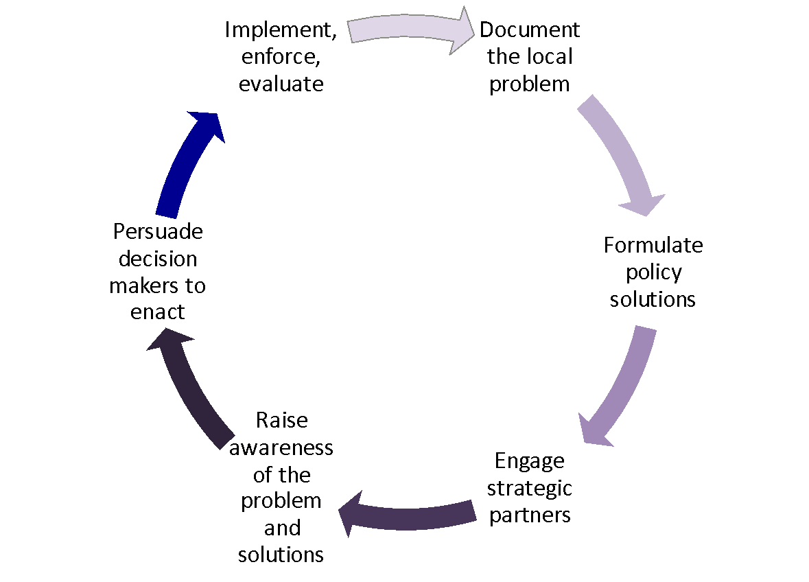
Policy Change Process

Slide 9
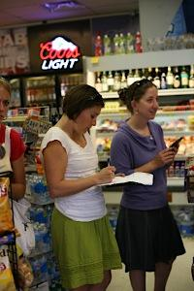
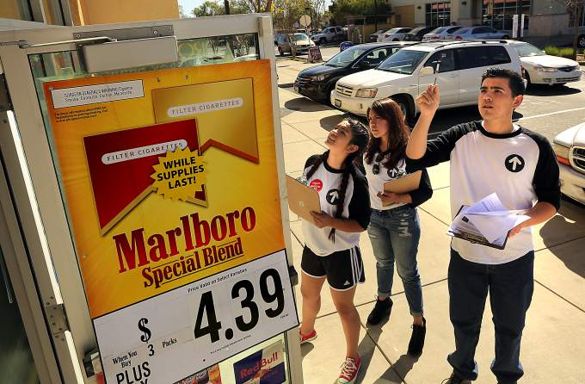
Engage Community Members
Notes:
The first reason is to engage yourself and your supporters in the retail environment. Store assessments can involve powerful, but infrequently heard voices, such as youth, community members, or coalition members.

Slide 10
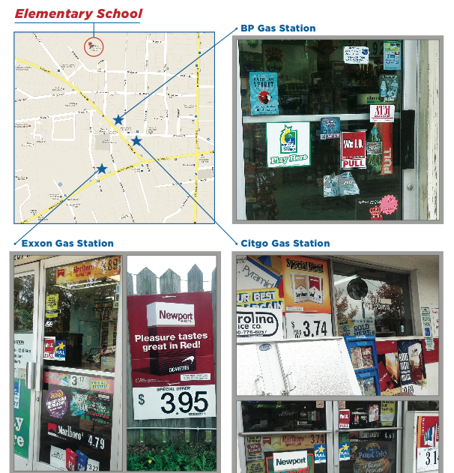
Collect High Quality Local Data
Notes:
Another reason to do store assessments is to collect high quality local data. The data collected is likely to be the most up to date and accurate data on what’s going on in the retail environment in your area.
I’ve put a couple pictures on this slide as a reminder that photographic data are a powerful way to showcase what is going on in your area and photos are easy to collect when conducting store assessments.
Image Source: Counter Tobacco

Slide 11
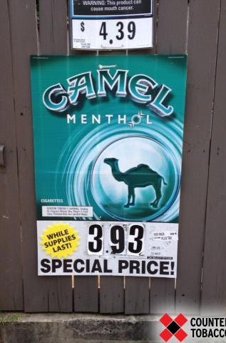
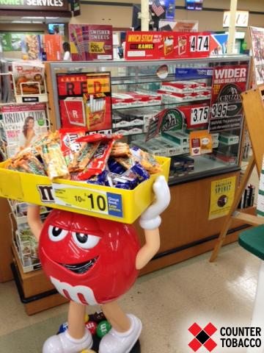
Document Industry Targeting
Notes:
Another reason is to document industry targeting. By looking at the data we collect, we can identify patterns such as targeting of youth or minority populations.
We can answer questions such as ‘Where are the most price promotions?’ and ‘Where do we most often see flavored products?’

Slide 12

Identify Policy Change Priorities
Notes:
The first step in policy change is identifying the problem. With store assessment data we can identify and prioritize the problems we find.

Slide 13
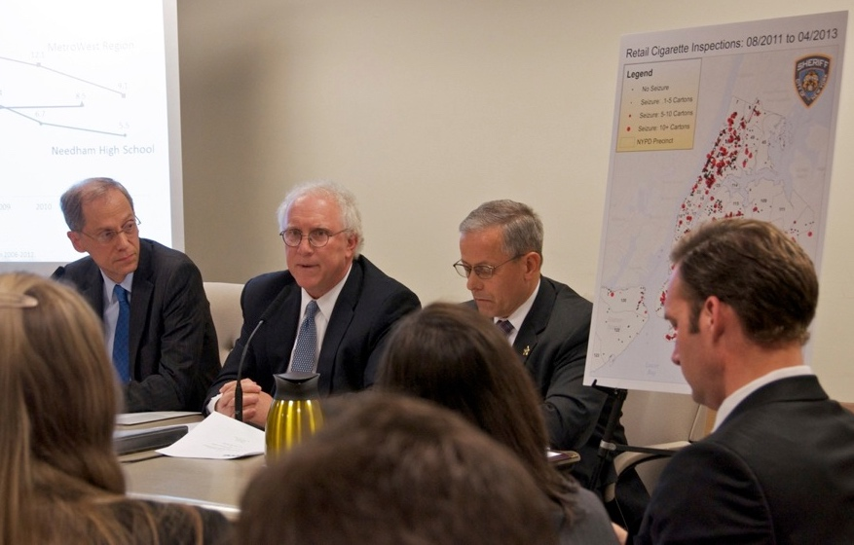
Educate Policymakers
Notes:
Educate policy makers using local data. It's pretty powerful when we can show policy makers what is going on in their backyard. Store assessment data provide clear and accurate advocacy points. local data.

Slide 14
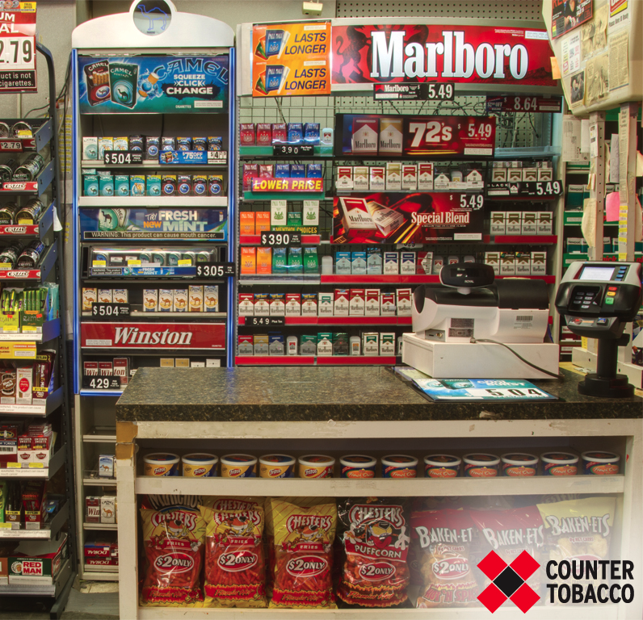
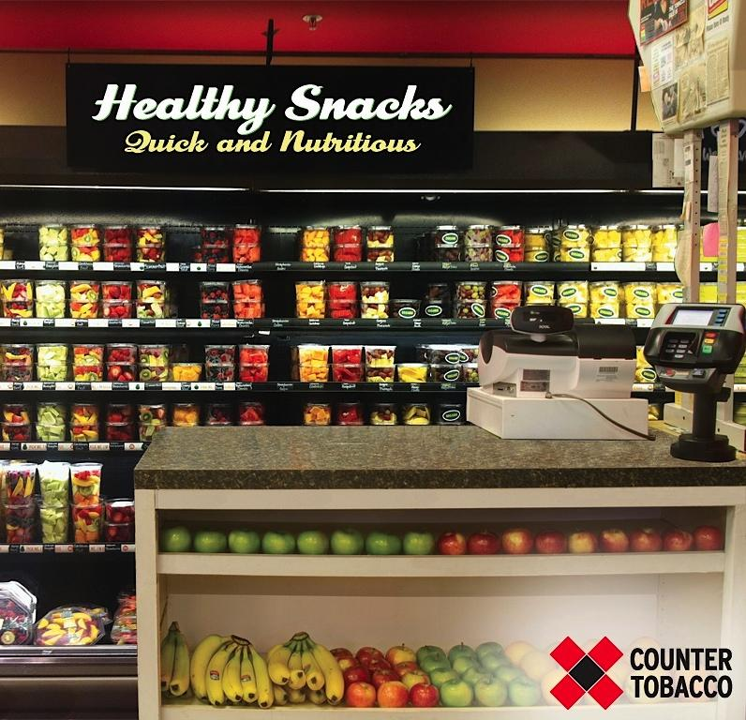
Evaluate Change
Notes:
With this data we can answer questions about how the retail environment changes over time, such as how new policies impact what's going on in stores. How is marketing changing? How is product availability changing?

Slide 15
Store Assessment Form Overview
Notes:
What does the form ask? What are best practices for answering the questions?
Why do you think we go over each question? Data quality matters. Everyone needs to answer the questions in the same way, or it means nothing.

Slide 16
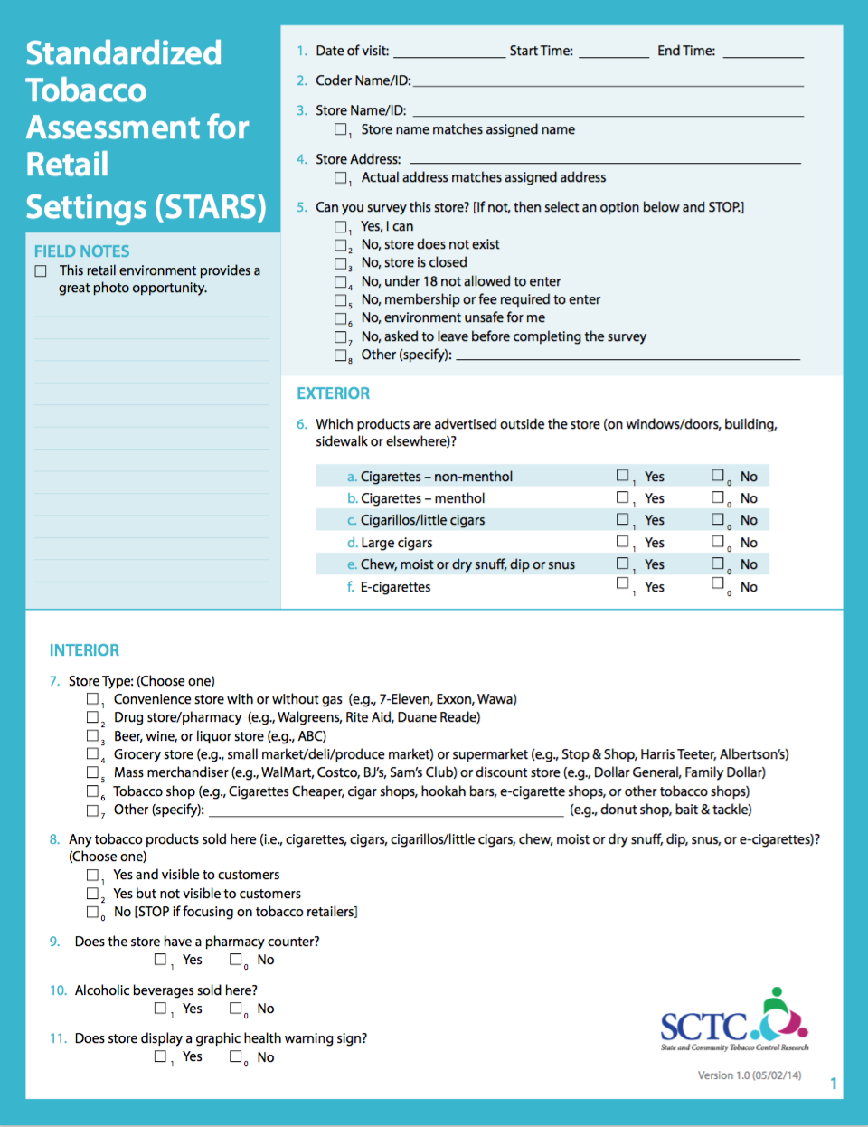
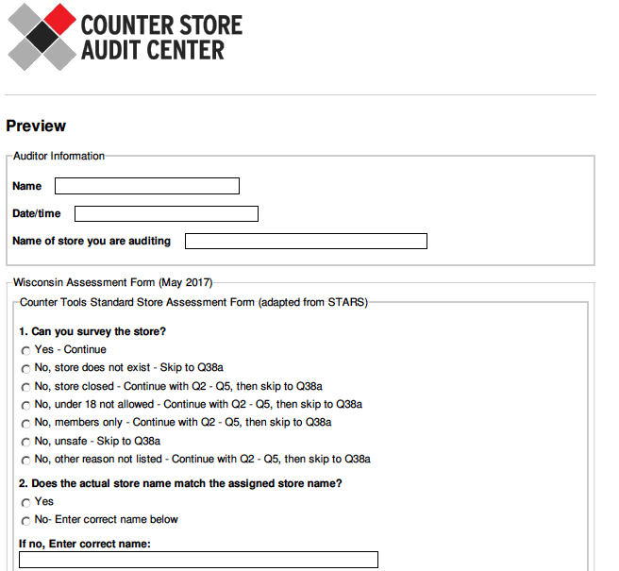
Wisconsin Store Assessment Form
Notes:
You have a copy in your folder.
All questions strategically chosen – linked with a potential policy
Based off of the national standard, STARS
Take a quick look at it – we’ll be practicing filling it out a little later
You’ll become very familiar with it
**Stress the importance of collecting good data.

Slide 17
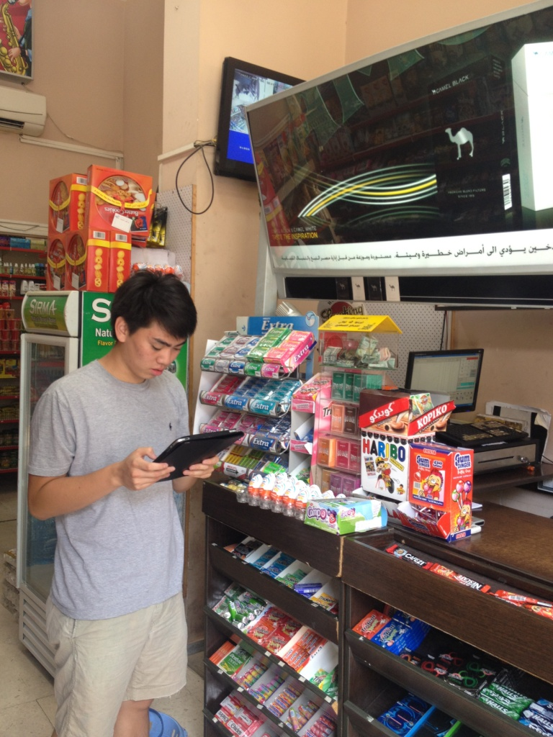
Wisconsin Store Assessment Form
Store name and location
Ability to survey store
Store type
Store exterior
Store interior
Tobacco products
Prices

Slide 18
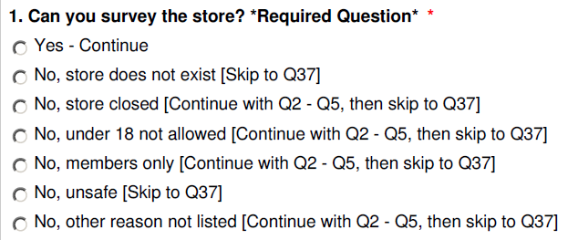
Q1: Ability to Survey Store
Instructions: Select the option that accurately describes whether or not you can survey the store.
See the next slide, or the In-Store User Guide, for details about each answer choice.

Slide 19
Q1: Ability to Survey Store
Question Response | Description
Yes, I can | Select if you are able to complete the assessment
No, store does not exist | Select if the store does not exist or is permanently closed.
No, store is closed | Select if you could not do the assessment because it is outside the store’s normal business hours and it is closed. Do not use this option if the store is permanently closed.
No, under 18 not allowed to enter | Select if you could not do the assessment because the store has an age limit on who can enter (e.g., the store is only open to people 18 and above) and you do not meet the age limit.
No, the store no longer sells tobacco | Select if the store no longer sells tobacco products.
No, environment unsafe for me | Select if you could not do the assessment because you felt that the store environment was unsafe for you.
No, asked to leave before completing survey | Select if you could not complete the assessment because you were asked to leave by a store employee before you finished the survey.
Other (specify) | If none of the above situations apply, select Other and specify the details of the situation and whether the assessment was completed.

Slide 20
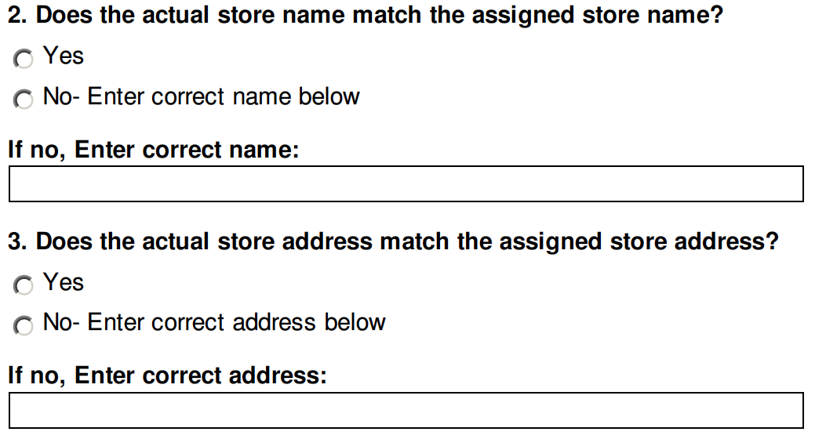
Q2 & Q3: Name & Address
Instructions: Confirm that the store name & address that was given to you matches the actual name & address. Enter the correct name if the information is not correct.

Slide 21
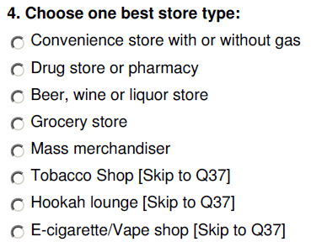

Q4: Store Type
Instructions: Select the type of store that you are auditing. You may only select one.
Review descriptions for each store type on the next slide.

Slide 22
Q4: Store Type
Store Type | Description | Examples
Convenience store with or without gas | Convenience store, also known as a food mart. Sells a limited line of goods that generally include milk, bread, soda and snacks. Some sell gas and others don’t. | 7-Eleven, Exxon, Wawa
Drug store/pharmacy | Known primarily for selling prescription drugs as well as over-the-counter medicines. | Walgreens, Rite Aid, local pharmacy
Beer, wine or liquor store | Mostly sell beer, wine or liquor and may sell a limited supply of snack foods. | ABC
Grocery Store | Includes a small market, deli, produce market, large grocery and supermarket (e.g., Publix, Winn Dixie). The difference between a convenience store and a grocery store is that grocery stores sell raw meat that is meant to be cooked at home. | Publix, Winn Dixie, [small local markets vary based on location]
Mass merchandiser | Mass merchandisers sell a variety of goods, including clothes, electronics, and food. Also include discount stores in this category. Discount stores sell a wide range of general merchandise, including fresh and perishable goods. | Mass Merchandiser: WalMart, Costco, BJ’s Sam’s Club; Discount Store: Dollar General, Family Dollar
Tobacco shop | Smoke shop or other retailer who primarily sells tobacco products. | Cigarettes Cheaper, Cigar shops, or other tobacco shops
Hookah lounge | An establishment where customers can order tobacco hookahs and smoke flavored tobacco (called shisha) – often in a communal setting. | Hookah bars, hookah lounges
E-cigarette/vape shop | Retailers that sell electronic cigarette vaporizers and paraphernalia (i.e. e-liquid, batteries, etc.) | Vary based on location

Slide 23
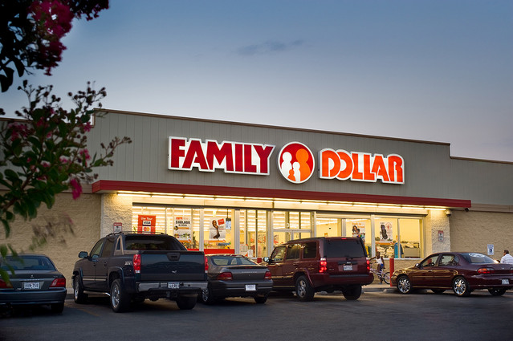
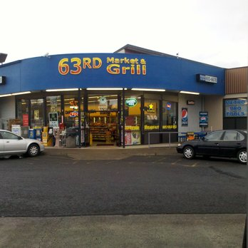
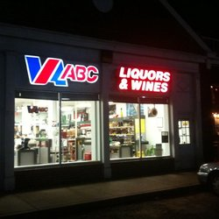
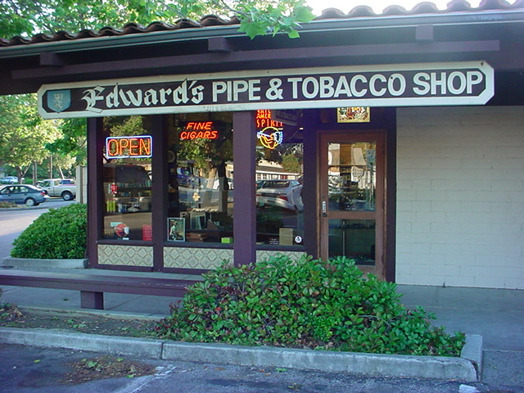
Pop Quiz:
Name that Store Type!
Notes:
Tobacco shop
Beer/wine/liquor store
General merchandise/mass merchandiser/discount store
Convenience Store with or without gas
Thanks for playing everyone!

Slide 24
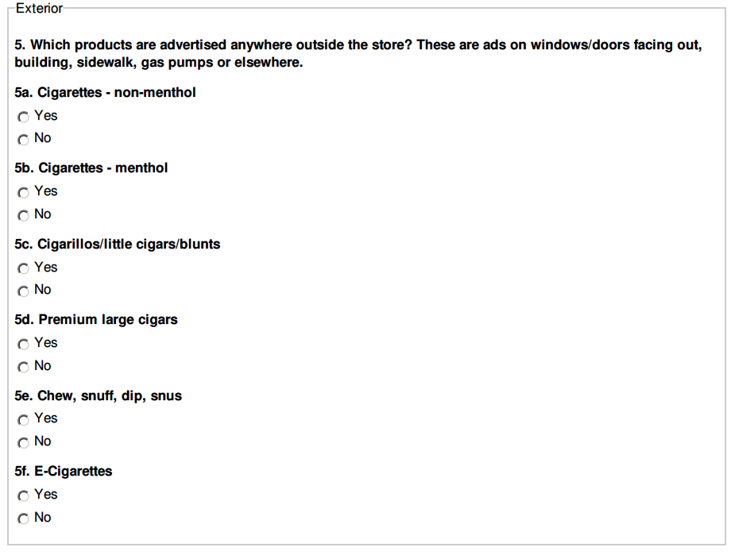
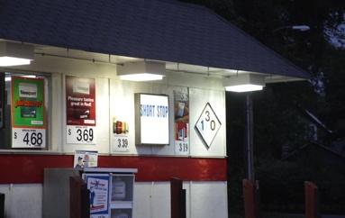
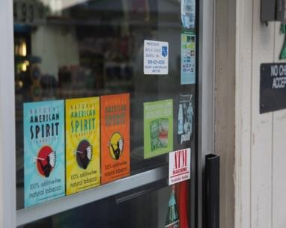
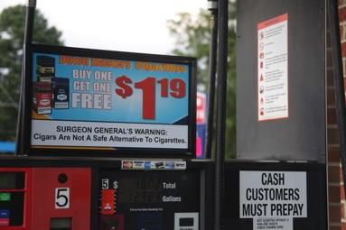
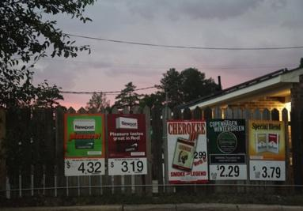
Q5: Exterior Advertisements
Instructions: Select Yes or No to indicate whether advertisements for each product can be found outside the store. Include any sign, poster, banner, decal, sticker, neon light or other three-dimensional object that promotes a brand.
Where to look for product ads:
Parking lot and sidewalks
Perimeter fences
Building windows and doors
Exterior building walls
Gas pump
Example
exterior ads:

Slide 25
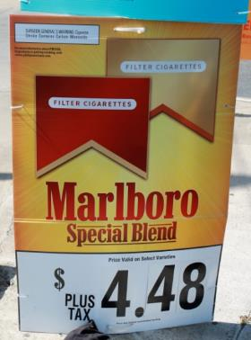
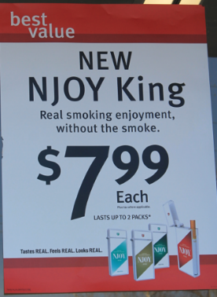
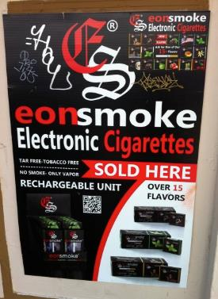
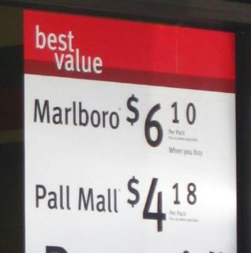
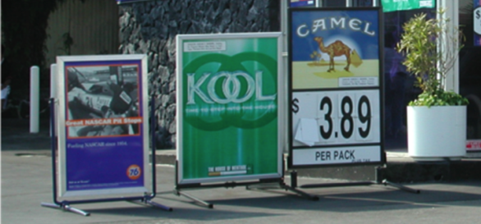
Advertisements are
Intended to sell products
Branded (name or logo)
Displayed as a sign, poster, banner or neon light
  With or without price
Printed, not hand-written
  Can have hand-written price information

Slide 26
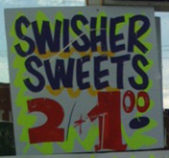
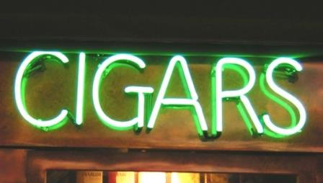
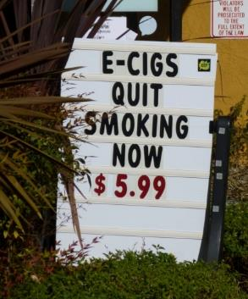
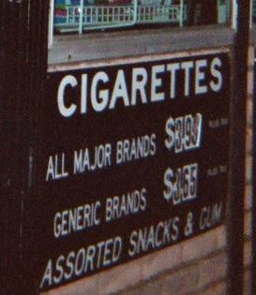
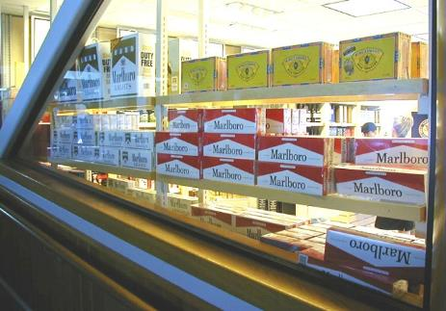
Advertisements are not
Store name
Hand-written promotions
Unbranded references (e.g., cigars, hookah, cigarettes)
Product displays inside that are visible through the window

Slide 27
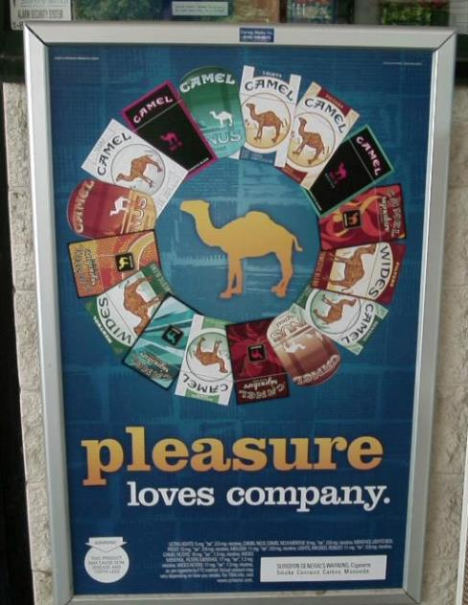
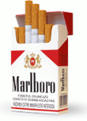
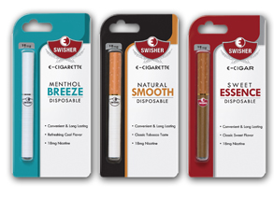

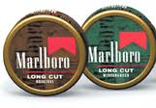
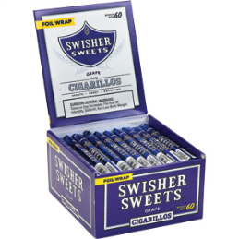
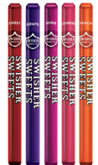
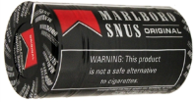
Signs that advertise more than one product
Marlboro
Swisher Sweets
This sign advertises:
-Cigarettes – non-menthol
Cigarettes – menthol
Snus
Some brands sell multiple
tobacco products, therefore
you might see signs that advertise more than one type of tobacco product.

Slide 28

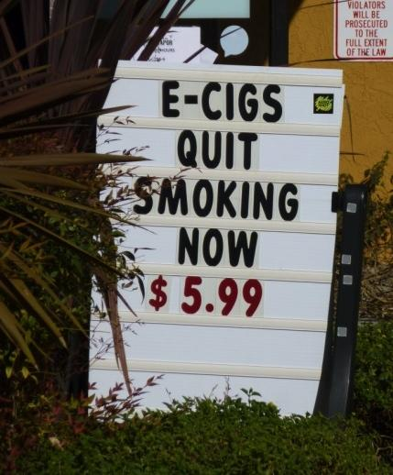

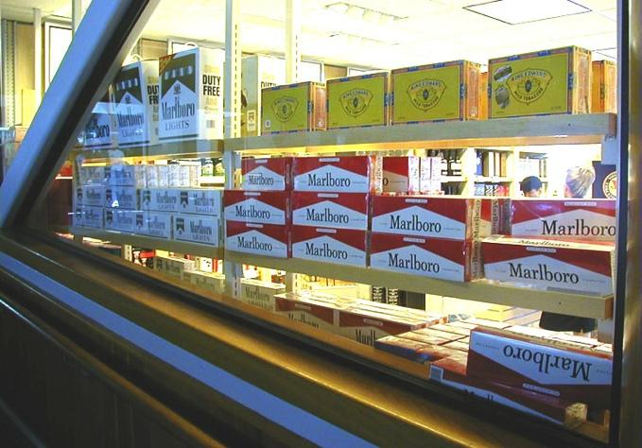
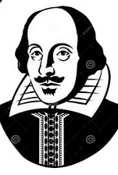
Pop Quiz:
To be or not to be?
Is it an advertisement or isn’t it? That is the question.
Notes:
Yes!
No!
No!
Yes!
No

Slide 29
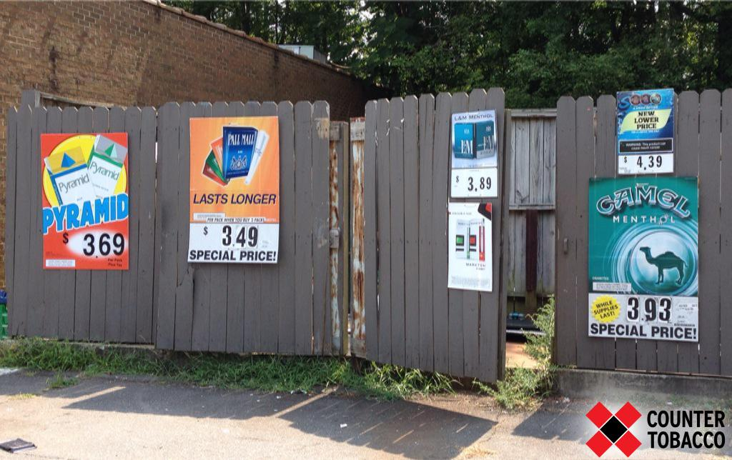
Pop Quiz!
Cigarettes –non menthol? Cigarettes –menthol? E-cigarettes?
Notes:
Question 4 – exterior advertisements
Cigarettes- non menthol – Yes.
Cigarettes –menthol – Yes.
E-cigarettes – Yes. (mark ten)

Slide 30
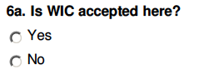
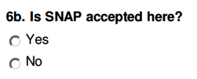
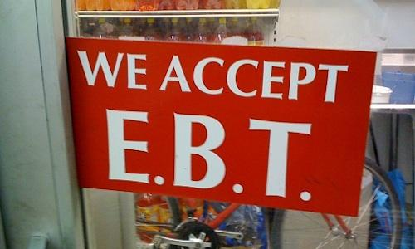
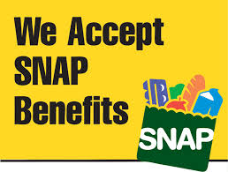
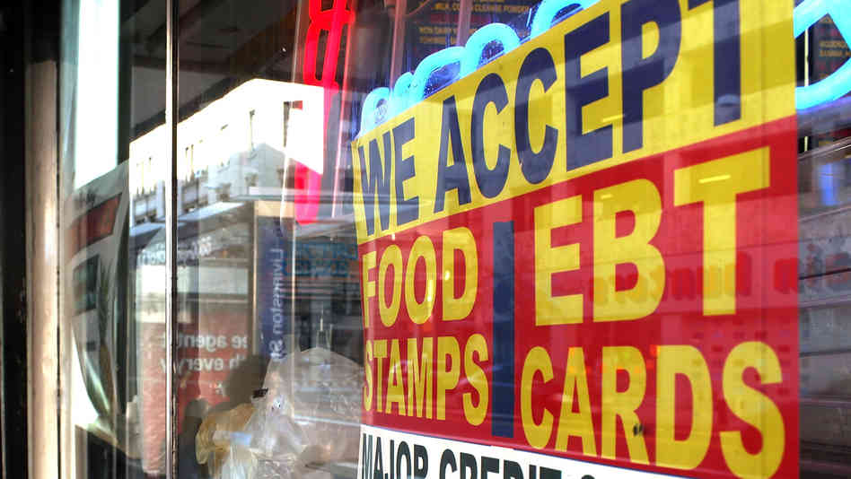
Q6: WIC & SNAP
Instructions: Select Yes or No to indicate whether the nutrition assistance programs WIC (Women, Infants, and Children) and/or SNAP (Supplemental Nutrition Assistance Program) are accepted. SNAP benefits generally come in the form of an EBT (Electronic Benefit Transfer) card, which is used like a debit card.
Look for signs indicating that WIC and/or SNAP are accepted. Signs are usually located near the entrance to the store.

Slide 31



Q7: Alcoholic Beverages
Instructions: Select Yes to indicate if there is any beverage sold that is designed for consumption and contains at least .5% alcohol by volume (e.g. wine, beer, spirits, alcopops).
This category does not include products that contain alcohol but are not meant for consumption as a beverage (e.g. cooking wine, vanilla).

Slide 32




Q8: Pharmacy Counter
Instructions: Select Yes or No to indicate whether the store has a separate pharmacy counter.
Notes:
This question is of interest because many municipalities are considering banning the sale of tobacco at pharmacies for the following reasons:
Selling tobacco in pharmacies sends a mixed message to consumers about the dangers of tobacco products since pharmacies are supposed to be health-oriented stores.
The presence of tobacco in pharmacies makes it harder for smokers to quit because tobacco is often sold next to cessation products.
Selling tobacco is a conflict of interest for pharmacists, who are dedicated to individuals’ welfare.

Slide 33

Pop Quiz!
Alcoholic beverages sold here?
Notes:
Smirnoff ice, Mike’s Hard Lemonade, Bacardi Breezer– alcoopops count as alcohol
Alcopop is a colloquial term describing certain flavored alcoholic beverages with relatively low alcohol content (e.g., 3–7% alcohol by volume), including: malt beverages to which various fruit juices or other flavorings have been added. Tend to be sugary and/or fruity.

Slide 34


Q9: Tobacco sold here?
Instructions: Select the appropriate answer based on whether or not tobacco products are sold in the retailer.

Slide 35




Where to look for tobacco products
Indicate that tobacco is still sold at the store even if the product is “out of stock”
Often near cash register
Walk around store, particularly if you are in a supermarket or mass merchandiser.
Sometimes advertisements are visible but products are not. Products might not be visible if they are in a covered display case.

Slide 36
Q10: Cigarettes
Instructions: For this question, you will be asked the following items about both menthol and non-menthol cigarettes. Answer Yes or No for each item.
10a. Sold here?
Select Yes if menthol OR non-menthol cigarettes are sold in the store. If no, skip to Q11.
10b. Enter CHEAPEST single cigarette pack: Record the cheapest advertised price to buy one pack of cigarettes. If the price is not available, leave the field blank. Do not compute this price from a multi-pack discount or from cartons. Record in format: XX.XX. *Do not enter $ sign*
10c. Cigarette (non-menthol) price promotions
Select Yes if there is a price promotion on the product. Look for words like “special value”, “special offer”, “discount”, “cents-off”, “reduced price”, “save $____”, “sale price”, “ special promotion”, “promotional offer”, “buy two get one free”, “two for the price of one” or “free pack with carton”.
Do not count words like “everyday low price”, “low”, “value brand”, “savings brand”, “basic”, “premium brand”, or “quality”.

Slide 37
Q10: Cigarettes
Instructions: For this question, you will be asked the following items about both menthol and non-menthol cigarettes. Answer Yes or No for each item.
10d. Menthol cigarettes sold here?
Select Yes if you see menthol cigarettes available for purchase. If no, please skip to Q10h.
10e. Newport Menthol cigarette single packs (regular hard pack) sold here?
Select Yes if you see Newport menthol cigarettes available for purchase. If Yes, enter price, and sales tax information. If no, please skip to Q10g.
10f. Enter Newport Menthol cigarettes single pack advertised price (regular hard pack)
Record in format: XX.XX. *Do not enter $ sign*
10g. Menthol cigarettes price promotions?
Select Yes if you see price promotions for menthol cigarettes. Refer to in-store user guide for guidance.
10h. Menthol or non-menthol cigarettes within 12 inches of youth products?
Select Yes if product is placed within 12 inches (roughly two hand lengths) of toys, candy, gum, slushy/soda machines, ice cream, etc. Look on the counter, below the counter, behind the counter, or any place else in the store where tobacco is displayed. Note: granola bars do not count as candy; mints do count.
10i. Cigarette ad (menthol OR non-menthol) within 3 feet of the floor
Select Yes if you see an ad for the product displayed within 3 feet off the ground, which is roughly at or below a child’s eye level.

Slide 38




Price promotions are
Signs or package labels that indicate sale (cents or dollar-off), discount, time-limited or trial offer
  Can be hand-written
Do not need to know difference between special price and multi-pack discount price promotions
Look outside the store on windows, doors, side of building or sidewalk for price promotions if none are visible in the store for a tobacco product
Special price: Indicated by terms such as “special value”, “discount”, “cents off”, “on sale”, “reduced price”, or “limited time offer”
  Multi-pack discount: An offer to purchase more than one item that results in a lower price (e.g., buy-one-get-one free, get 5 free when you buy 3, pay $__ when you buy more than one)
Follow along in your pocket guide

Slide 39










Price promotions are not
Cigarette carton deals
Signs that have statements like, “low price”, “everyday low price”, “value brand”, “great price”, and “best value”
Just any sign with a price is not a promotion because it is only displaying the everyday price of the item and doesn’t have words associated with a special price (e.g., “reduced price”)

Slide 40






Examples of cigarette price promotions
NOTE: Ignore cigarette cartons. Menthol cigarette price promotions are considered cigarette price promotions

Slide 41




Examples of menthol cigarette price promotions
NOTE: Ignore menthol cigarette cartons. Only consider menthol cigarette price promotions.

Slide 42






Examples of cigarillo/little cigar price promotions

Slide 43






Examples of chew, moist/dry snuff, dip or snus price promotions

Slide 44



Examples of e-cigarette price promotions

Slide 45




Pop Quiz:
To be…or not to be, round 2
Is it a price promotion or isn’t it? That is the question.
Notes:
No – low price.
Yes – special price
YES – trial offer
No –standard price.
Yes – all say special!

Slide 46



Q11 – 14: Other Products
Instructions: For these questions, you will be asked a combination of the items below. Answer Yes or No for each item asked for each product.
Sold here?
Select Yes if the product is sold in the store.
Flavored products
Select Yes if the product is available in flavors, including mint, fruity (cherry, berry, grape, peach) or candy flavors.
Not flavors: Black, mild, regular, purple, etc.
Singles (question only for cigarillos/little cigars/blunts)
Select Yes if you can purchase just one cigarillo or blunt outside of a pack.
Advertised for less than $1 (question only for cigarillos/little cigars/blunts)
Check Yes if you can find a cigarillo for less than $1.00. Answer Yes or No based on the advertised price, regardless of whether it includes tax or not.
Notes:
Cigarillos/little cigars/blunts
Premium large cigars
Chew, moist/dry snuff, dip, or snus
E-cigarettes
Hookah tobacco
Loose tobacco

Slide 47



Q12 – 14: Other Products
Industry is buying health behavior impact
Instructions: For these questions, you will be asked a combination of the items below. Answer Yes or No for each item asked for each product.
Within 12 inches of youth products
Select Yes if tobacco is placed within 12 inches (roughly two hand lengths) of toys, candy, gum, slushy/soda machines, ice cream, etc.. This could be on the counter, below the counter, behind the counter, or any place else in the store where tobacco is displayed. Note: granola bars do not count as candy; mints do count.
Product ad within 3 feet of the floor
Select Yes if you see an ad for the product displayed at or below a child’s eye level, which is about 3 feet off the ground. This refers to interior ads only.
Vendor-assisted displays
Select Yes if the product is only accessible by asking the clerk.
Notes:
Cigarillos/little cigars/blunts
Premium large cigars
Chew, moist/dry snuff, dip, or snus
E-cigarettes
Hookah tobacco
Loose tobacco

Slide 48


Q12 – 14: Other Products
Industry is buying health behavior impact
Instructions: For these questions, you will be asked a combination of the items below. Answer Yes or No for each item asked for each product.
Product price promotions
Select Yes if there is a price promotion on the product. Look for words like “special value”, “special offer”, “discount”, “cents-off”, “reduced price”, “save $____”, “sale price”, “ special promotion”, “promotional offer”, “buy two get one free”, “two for the price of one” or “free pack with carton”.
Do not count words like “everyday low price”, “low”, “value brand”, “savings brand”, “basic”, “premium brand”, or “quality”.
Cross-product promotion with cigarettes:
Select Yes if there is a promotion that links cigarettes with another tobacco product. For example, a free tin of snus when you purchase Camel cigarettes.
Notes:
Cigarillos/little cigars/blunts
Premium large cigars
Chew, moist/dry snuff, dip, or snus
E-cigarettes
Hookah tobacco
Loose tobacco

Slide 49


Flavored products?
Tobacco products come in a variety of flavors
Tobacco products that can be flavored include cigarillos/little cigars, large cigars, chew, snuff, dip or snus, and e-cigarettes
  The only flavored cigarettes are menthol cigarettes
You do not need to tell the difference between flavor types (e.g. fruit, liquor) – you only need to find one flavor of any type
Flavor examples
Fruit or sweet | Liquor | Mint
Apple (green, wild) Cherry Chocolate Cinnamon Cream Grape (white, red) Honey Java Peach Spice Strawberry Sweet Vanilla | Bourbon Cognac Margarita Peach schnapps Pina Colada Spiced Rum Whiskey Wine Wine grape | Fresh Frost Menthol Peppermint Spearmint Wintergreen Winterchill
Follow along in your pocket guide
Note: these are only examples of flavors and not an exhaustive list

Slide 50








Not flavors
The following are not considered flavors:
  Black
  Bold
  Diamond
  Jazz
  Mild
  Perfecto
  Purple or purple haze
  Red
  Regular
  Royale

Slide 51

Pop Quiz!
Chew, moist/dry snuff, dip, snus sold here?
Self-service display?
HINT: counter →
Notes:
Chew, moist/dry snuff, dip, snus sold here? YES
Flavored? Vendor assisted display? YES

Slide 52

Pop Quiz!
Blu disposable e-cigarette sold here?
Notes:
Blu disposable e-cigarette sold here? YES.
Vendor Assisted Display?

Slide 53


Q15 & Q25
Instructions: For these questions, select the answer to indicate whether or not you are collecting data about alcohol and food retail during this project.
See additional training materials for instructions on how to answer each of these questions. Alcohol: 15 – 25; Food/Beverage: 26 – 36.

Slide 54

Q37: Field Notes
Instructions: If you have any notes to add, type them in the notes field.

Slide 55

Q38: Photo Upload
Instructions: Optional. Please consult with your coordinator about taking photos during assessments.

Slide 56
Tobacco Product Glossary

Slide 57



Product Descriptions
Product | Description | Examples
Cigarettes – non-menthol | The most widely available tobacco product, typically sold in packs and cartons. Popular brands include Marlboro, Pall Mall, Camel, and Winston.
Cigarettes – menthol | Cigarettes that are marketed as containing menthol. Typically sold in green packs, but may come in other colors. Popular brands include Kool, Newport, Salem, and Marlboro menthol. Also includes fresh, frost, mint, peppermint, spearmint, winterchill, and wintergreen.
Cigarillos/ little cigars | May be sold individually, a few in a pack, or in a pack of 20 that looks like a cigarette pack. They are short (3-4 inches) or the size of a cigarette. Popular brands include Swisher Sweets, White Owl, and Prime Time.

Slide 58




Product Descriptions
Product | Description | Examples
Large cigars | Often sold as singles but can also be found in boxes. Some cigarillos/little cigars have the word “cigar” on the package (e.g. “25 pipe-tobacco cigars”), however these are not considered large cigars because they are sold in a pack and are smaller than large cigars.
Chew, moist or dry snuff, dip or snus | Packaged in cans or pouches and usually shelved near cigarettes. Popular brands include Copenhagen, Grizzly, Skoal, Redman, Swedish Match, Camel, and Klondike.
E-cigarette products (aka ENDS and e-juices) | This includes electronic cigarettes, and any product associated with e-cigarettes (i.e. e-juice). E-cigarettes are batter-powered devices that produce vapor instead of smoke (disposable or refillable). They may be displayed with tobacco products or available in a self- service container. Popular brands include Blu, NJOY, Vuse, Swisher, and Krave.

Slide 59



Product Descriptions
Product | Description | Examples
Hookah/ shisha | Tobacco used in hookahs is typically leaf flavored with molasses, honey, or dried fruit. In the United States this is typically referred to as shisha.
Tobacco-related devices | Tobacco-related devices include pipes, rolling papers, ashtrays, or other devices intentionally designed or intended to be used in a manner which enables the chewing, sniffing, or smoking of tobacco or tobacco products.

Slide 60


Product overview
Pocket Guide: Page 2-3
Notes:
Refer to your pocket guide or use it later as a reference

Slide 61

Cigarettes
Refer exclusively to tobacco cigarettes
  Does not include electronic cigarettes
Cigarettes may be menthol cigarettes or non-menthol
Follow along in your pocket guide

Slide 62







Popular brands of cigarettes
Popular brands include Marlboro, Newport, Pall Mall, Camel, and Winston

Slide 63

Menthol cigarettes
Menthol is the only flavored cigarette permitted by federal law
Typically green packs but may come in other colors
Follow along in your pocket guide

Slide 64

Popular brands of menthol cigarettes
Popular brands include Newport, Salem, Kool, and Marlboro menthol

Slide 65

Cigarillos/little cigars
Tobacco wrapped in a tobacco leaf (or a brown paper containing tobacco)
Short (3-4 inches) or the size of a cigarette
  Smaller than a large cigar
May be sold individually, a few in a pack, or in a pack of 20 or more that looks like a cigarette pack
  Blunt and blunt wrappers are considered cigarillos/little cigars
Follow along in your pocket guide

Slide 66






Popular brands of cigarillos/little cigars
Popular brands include Swisher Sweets, Black & Mild, Phillies, and White Owl

Slide 67







Single cigarillos/little cigars
Smaller unit sizes indicate lower purchase prices
Examine the brands of cigarillos/little cigars to try and find single cigarillos/little cigars
Does not count as single cigarillo/little cigars because it is sold in packs of two

Slide 68

Large cigars
Typically contains at least one-half ounce of aged, fermented tobacco wrapped in tobacco leaf (or a brown paper containing tobacco)
Often sold as singles but can be found in boxes
Larger than cigarillos/little cigars
Follow along in your pocket guide

Slide 69




Images of large cigars
NOTE: Some cigarillos/little cigars have the word “cigar” on the package (e.g. “25 pipe-tobacco cigars”). These are not considered large cigars since they are sold in a pack and are smaller than a large cigar.

Slide 70

Chew, moist or dry snuff, dip or snus
These are different forms of smokeless tobacco all treated as one product category
You don’t need to recognize the difference between chew, snuff, dip or snus
The products are packaged in cans or pouches and are usually shelved near cigarettes.
Follow along in your pocket guide

Slide 71







Popular brands of smokeless tobacco
Popular brands include Marlboro, Camel, Skoal and General

Slide 72

Electronic cigarettes (E-cigarettes)
Battery-powered devices that produce vapor instead of smoke
  Can be disposable or refillable
Using e-cigarettes is called vaping
Category does not include e-hookah or e-cigars
May be shelved with tobacco products, in a self-service container or with nicotine-replacement products like Nicorette
  Some e-cigarette displays advertise “100% water vapor”
Follow along in your pocket guide

Slide 73








Popular brands of e-cigarettes
Popular brands include JUUL, Blu, NJOY, MarkTen, Swisher and Starbuzz

Slide 74
General Instructions &
Store Etiquette

Slide 75
General Instructions
1-2 people per team
Regular store hours, during daylight
If the store is busy, wait a few minutes
If you don’t feel safe, leave
You can do 6-12 audits per day*
Always scroll to the right on the audit form if using a mobile device
*on average, depending on location of retailers

Slide 76


General Instructions
For all stores: conduct exterior assessments without asking permission
For large stores: don’t need to ask permission. If asked, explain study and provide informational letter if needed
For small stores: better to ask permission, provide informational letter if needed

Slide 77

Store Etiquette
Be aware of store employees, stockers, and other shoppers
  Avoid standing in front of any one area for a long period of time
  Avoid areas where workers are stocking the shelves
Respect the personal bubble!

Slide 78

Store Etiquette
Don’t be too obvious when looking at ads
Do not pick up or handle any tobacco products
Consider making a purchase (gum, mints, water)

Slide 79
Introducing the Project
Hello, my name is _______________. I am working on a project with the youth in our community where we are measuring the kinds of products that are sold in our stores.
Would you mind if I looked around? It will only take a few minutes. I will not get in the way of your customers.

Slide 80

What questions can I answer?

Slide 81
Five Steps to Being a Team Member
Notes:
We know why we do store audits, but how will we do them? With the help of a tool called the store Audit Center. I should say that the word “audit” and “assessment” are interchangeable.

Slide 82
Overview
Receive invitation
View Assignments
Open Audit Form
Collect Data
Submit Data

Slide 83


1) Receive Invitation
Receive invitation email with the subject “Ready to audit?” containing:
  List of stores you’ve been assigned to audit, with names, addresses and map links
  Link to perform audits using the Store Audit Center at bottom of email
Web browser recommendations for collecting data on mobile devices
Android devices: Firefox
Apple (iOS) devices: Safari
Avoid using Chrome on mobile devices
online
print

Slide 84


2) View Assignments
Two Options
View Map
OR
View List
Notes:
Two options:
View Map – Click on store, click on Do Audit
View List – Click on store, click on Do Audit
*Sometimes it will say your name instead of ‘Do Audit’

Slide 85

3) Open Audit Form
Campaign
Assessment Form
“roadmap”
Store Location
Assessment Form Title
Questions
Notes:
Wisconsin Store Assessment Form comes up, and you can answer the questions on your mobile device in the retailer.
Notice it has the name of the campaign on the top left, the name of the form, and your “roadmap” on the right.

Slide 86


4) Collect Data
Audit form
Base module
Notes:
Always scroll to the right on the assessment form.

Slide 87

5) Submit Data

Slide 88
Worksheet Practice & Review

Slide 89
Practice Store Assessment

Slide 90

Welcome to…
Wisconsin
Corner Store

Slide 91


Slide 92




Slide 93


Slide 94



Slide 95


Slide 96


Slide 98


Slide 99
Wrap-up

Slide 100
Wrap-up
Thank you for volunteering!
Reminders:
  Timeline
  Due Dates:
  First step after today?
Contact Information:__________________

