Slide 1
Other Tobacco Products and E-cigarettes
A Growing Concern
Your logo here (or delete this box)

Slide 2
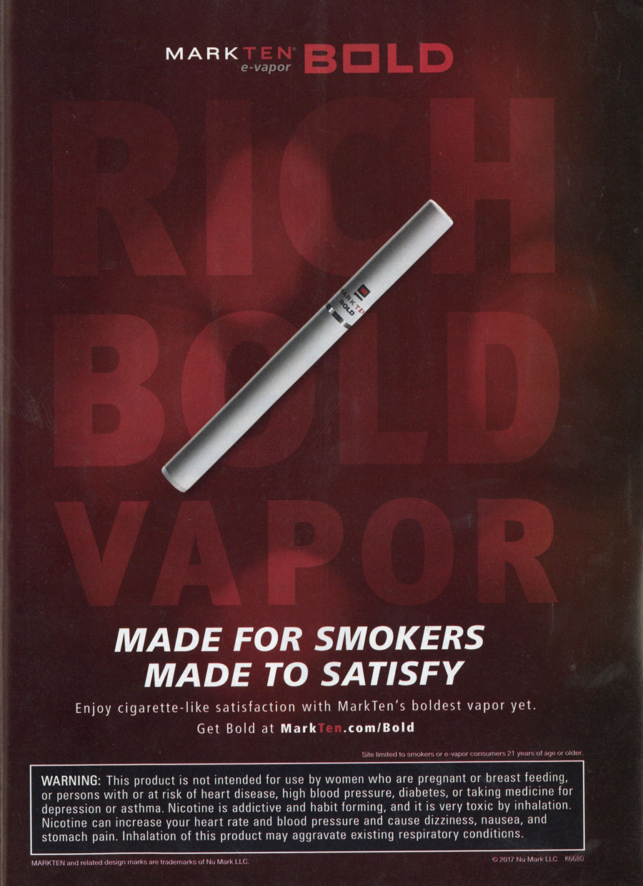
The tobacco industry isn’t going anywhere.
Notes:
Wisconsin passed a statewide smoke-free air law and has had success increasing the cigarette tax increase.
BUT…there is still work to do. The Tobacco Industry isn’t just going to concede a loss and leave Wisconsin. They are still here, trying to make a profit - in a BIG way.
As cigarette smoking rates have dropped, the tobacco industry has developed and marketed products as a way to attract new customers and keep users hooked by promoting them as a way to get around current smoke-free air laws.
These products include "other tobacco products“ including e-cigarettes.
Photo source: https://www.trinketsandtrash.org/viewImage.php?file_name=218327.jpg, https://www.trinketsandtrash.org/images_detail/210632.jpg

Slide 3
What are Other Tobacco Products?
Notes:
Other Tobacco Products, or OTP, represent products that contain tobacco but are not cigarettes.
These products aren’t safe alternatives.
They contain nicotine and other carcinogens, which can cause cancer, heart disease and other health issues.
Note: E-cigarettes aren’t technically a “tobacco product” but they do contain nicotine.
Photo source: http://tobwis.org/files/large/1b154e0671d9acab0050da3b6979a5e5.png

Slide 4
What is the Problem?
Appealing packaging and easily accessible
Candy flavoring
Cheap and addictive
Notes:
Tobacco companies are putting a lot of money into creating and marketing these new products.
And that’s a problem because of their packaging, shapes, and flavors.
To the unseasoned eye, they are almost indistinguishable from candy and mints. And who likes candy? Kids.
These products are cheap because they’re not taxed the same way cigarettes are.
In Wisconsin, we are seeing more youth using these products.

Slide 5
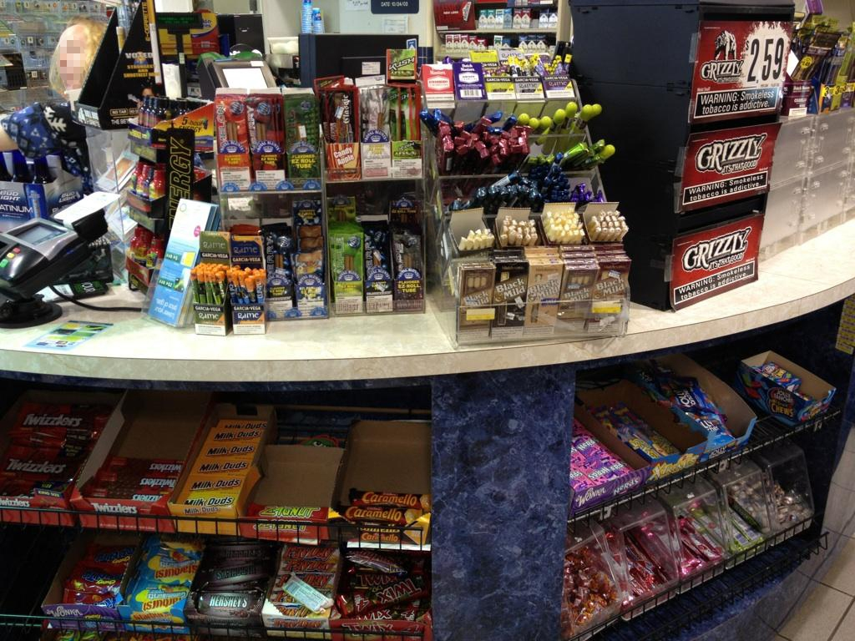
Appealing Packaging and Easily Accessible
Notes:
As mentioned before, most of these OTPs are available at tobacco retailers statewide
A popular place to display OTPs is at point of purchase.
Some OTP can even be found next to gum and candy, as shown here.
Customize slide by adding a picture from local retail assessment/environmental scan. Share Wisconsin Retail Assessment Project (WRAP) data/stories and how the coalition is collecting these photos and information about local tobacco retail environment through assessments.
Photo source: http://countertobacco.org/wp-content/gallery/main-galleru/WinnerNearCandy-CigaretteCandyDisplay_VA_retouched_faceblur.jpg

Slide 6
Candy Flavoring
Notes:
Although the Tobacco Control Act, which was implemented in 2009, regulated flavored cigarettes, the law doesn’t currently apply to flavored OTPs.
And with flavors like grape and chocolate, the tobacco industry has their sights set on our youth.
Default photo shows the color and flavor comparison between OTPs and actual candy/sugary beverages.
Customize slide by adding a picture from local retail assessment/environmental scan.
Photo source: http://tobwis.org/files/large/717fdabc7e42bc4

Slide 7
Cheap and Addictive
Notes:
A loophole in Wisconsin law allows some tobacco products to be treated differently than cigarettes, making these fruit-flavored tobacco products cheaper and more accessible to Wisconsin youth.
Functionally, little cigars are cigarettes. However, because they are wrapped in brown paper containing tobacco, they have been misclassified in law as “other tobacco products.”
Not only are these products cheap, they are also addictive and NOT a safe alternative to cigarettes.
All cigarettes are taxed at $2.52 per pack. Why should little cigars and other cigarette-like products be treated differently?
Photo source: http://tobwis.org/files/download_file/55a9b2f1aeff9e7

Slide 8
Electronic Cigarettes
Notes:
Another product being marketed and sold is electronic cigarettes, or e-cigarettes.
They are advertised as a more attractive alternative to conventional cigarettes. Common marketing messages claim that e-cigarettes are cleaner and cheaper than conventional cigarettes.
With these products getting a lot of attention, sales and usage are increasing.
E-cigarette use has surpassed conventional cigarette use among youth.*
*https://www.dhs.wisconsin.gov/publications/p01624.pdf
Photo source: https://www.trinketsandtrash.org/viewImage.php?file_name=217828.jpg , https://www.trinketsandtrash.org/viewImage.php?file_name=217693.jpg

Slide 9
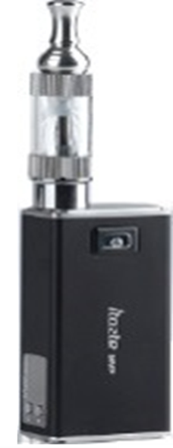
What is an E-Cigarette?
Cigalike
Vape Pen
Mod
Notes:
E-Cigarettes are devices that allow users to inhale an aerosol containing nicotine and other substances.
They are battery-operated devices that use a vaporizer to heat a cartridge containing e-juice, that then releases a chemical-filled aerosol.
E-Cigarettes can be purchased either as disposable devices or reusable devices. The disposable devices already have the e-juice loaded into the cartridge. It is used until the device is empty and then thrown away.
Reusable devices are the most popular device where the user purchases a desired flavor and nicotine level of e-juice that they put into their reusable e-cigarette.
The pictures here show a:
‘cig-a-like’ – made to look and feel like a conventional cigarette, they are small, light and mimic all the design features of real cigarettes (most are disposable)
‘vape pen’ – one of the most common, reuseable types, these can be filled with the user’s choice of e-liquid
‘mod’ – bigger devices, more powerful and customizable (batteries, heating coils), these create larger clouds of vapor and heat hotter than vape pens
The long-term health consequences of these devices is currently unknown and there is no scientific evidence that establishes the safety of e-cigarettes. E-cigarettes are currently not regulated by the FDA.
Photo sources:
Cigalike: http://www.truthinitiative.org
Vape Pen: https://static01.nyt.com/newsgraphics/2014/03/04/ecig-graphic/8513ddbb2a05c99414b514b749cc675c67189193/0305-biz-ecig-artboard_2.png
Mod: http://www.vaporclubs.net/wp-content/uploads/2013/10/Vapor-Club-Innokin-iTaste-MVP-2600maH-e-cig-battery600.jpg

Slide 10
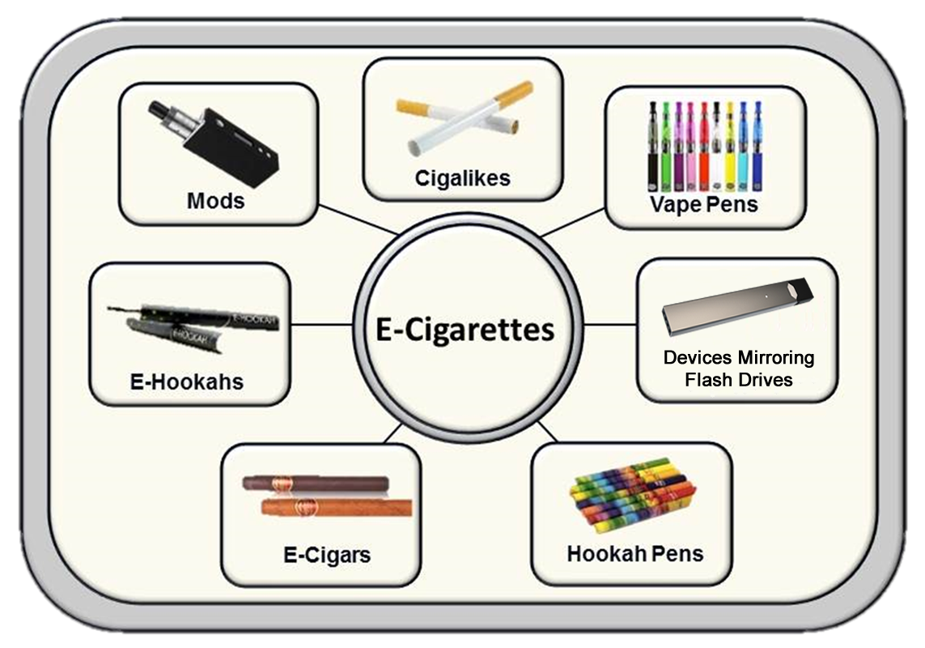
What is an E-Cigarette?
Notes:
“E-cigarette” is a general term used to reference an array of products that simulate smoking.
They take many forms. Types of e-cigarettes include mods, cigalikes, vape pens, devices mirroring flash drives, hookah pens, e-cigars, and e-hookahs.
Photo source: Health & Policy Implications, National Synar Workshop, 5/6/14, Brian A. King, PhD, MPH, Office on Smoking and Health, Center for Disease Control and Prevention

Slide 11
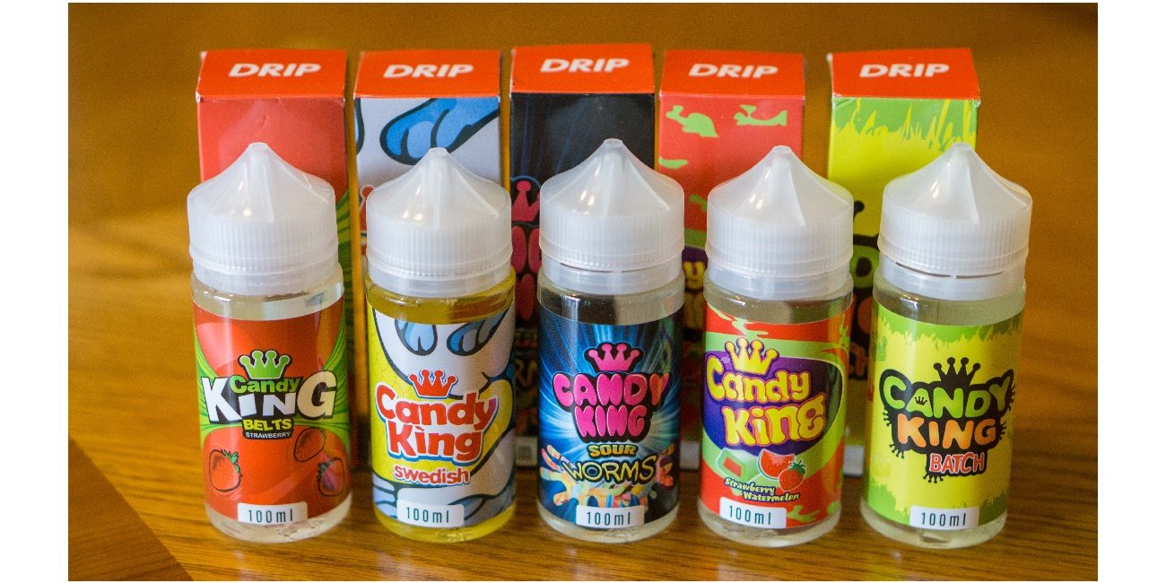
E-Juice
Notes:
E-juice is the liquid that is put inside of an e-cigarette to be inhaled.
Currently, there are over 7,700 flavors of e-cigarettes and e-juice. E-juice comes in many sweet flavors that are attractive to users, such as strawberry, watermelon, and sour gummy worms. 1 out of 3 youth tried e-cigarettes because they tasted good.* Almost 88% of youth think they would not try an e-cigarette if it did not have any flavor such as mint, candy, fruit, or chocolate. **
A 2014 study found that out of 159 e-juice samples, 75% contained diacetyl.*** Diacetyl has even been found in e-juice labeled as “diacetyl-free”. Diacetyl is added to e-juice because it gives products a creamy, smooth taste and finish. And a new study published just this month by Harvard, found that the chemical is common even in less-obvious flavors such as watermelon. Diacetyl is a chemical that has been approved for use in food by the Food and Drug Administration, or the FDA, but when inhaled it is associated with lung disease.****
Nicotine has also been found in some e-juices.*** Nicotine is highly addictive, and it can have lasting effects on adolescent brain development, including permanently lowering impulse control and damaging parts of the brain that control attention and learning.*****
Photo source: https://vapingcheap.com/wp-content/uploads/2017/02/Candy-King-E-Liquid-Review-1300x650.jpg
*http://www.monitoringthefuture.org/pressreleases/15ecigpr_complete.pdf
**https://www.dhs.wisconsin.gov/publications/p01624.pdf
***https://www.ncbi.nlm.nih.gov/pmc/articles/PMC4892705/
****http://ehp.niehs.nih.gov/15-10185./
*****https://www.tobaccofreekids.org/assets/factsheets/0394.pdf

Slide 12
Not Approved to Help Smokers Quit
Notes:
Despite proponents’ claims, not one of these products has been approved by the FDA as a cessation device.
We know what works. The combination of cessation counseling and FDA-approved medications, such as nicotine patches, lozenges and gum, is the most effective strategy to help smokers quit.
Additionally, three out of four e-cigarette users (76.8%) often continue to smoke regular cigarettes as well as use e-cigarettes.*
E-cigarettes are marketed as a way to circumvent clean indoor air laws. For example, users smoke e-cigarettes indoors and regular cigarettes outside.
Since these products are being marketed as an alternative for smokers when they cannot smoke, their use can potentially lead to the dual use of cigarettes and e-cigarettes.
This means they don’t quit. They just use a new, potentially harmful product in addition to continuing to smoke.
Photo source: http://4.bp.blogspot.com/-unUtbQ4ghnk/UUoIhP20nXI/AAAAAAAAADY/EsjbIz-A0C0/s1600/IFWT-Blu-Cigs-avail.png
*https://www.tobaccofreekids.org/research/factsheets/pdf/0380.pdf

Slide 13
Appeal to Youth
Notes:
Flavors, packaging, and marketing of products through online promotions and social media platforms such as Snapchat, Instagram, and YouTube can help make e-cigarettes especially appealing to youth.
JUUL is a new type of e-cigarette that resembles a USB flash drive. The JUUL device has surged in popularity since its introduction to the market, and has even inspired other companies to develop similarly designed devices. JUUL use has become so widespread that it has its own verb – youth and young adults refer to JUUL use as “JUULing” instead of “vaping” or “e-cigarette use”.*
JUUL’s small size and its close resemblance to a USB flash drive allows youth to discreetly use and easily hide the device. Customizable “wraps” or “skins” featuring different colors and patterns add to the device’s concealability.*
JUULpods come in kid-friendly flavors like Cool Mint, Fruit Medley, and Mango.*
JUULpods contain highly concentrated levels of nicotine. In fact, the amount of nicotine in one JUULpod is equivalent to the total nicotine in one pack of cigarettes.*
*https://tobwis.org/resources/view/308/JUUL_One_Pager_6r20Ydp.pdf
Photo source: http://www.adageindia.in/photo/47785165/marketing/cmo-strategy/Juul-Hopes-To-Reinvent-E-Cigarette-Ads-with-Vaporized-Campaign.jpg?548186

Slide 14
More Than Just “Water Vapor”
Notes:
E-cigarettes give off more than just “water vapor.”
E-cigarettes produce an aerosol (also referred to as vapor) upon each inhalation that resembles and tastes like the smoke produced by cigars and cigarettes.
While the health effects of the aerosol are unknown, initial lab tests conducted by the FDA found detectable levels of toxic cancer-causing chemicals, including an ingredient used in anti-freeze.*
10 known carcinogens, heavy metals (including tin, silver, copper, and lead) and volatile organic compounds have been identified in the e-cigarette aerosol.**
Two new articles were released in the past year that showed levels of diacetyl and formaldehyde in the e-cigarette aerosol, chemicals that are known to be harmful to the human body. The study about formaldehyde found that when e-cigarettes are heated at their highest settings, inhaled formaldehyde was 5 to 15 times higher than cigarettes.***
E-cigarettes can undermine clean indoor air policies. If exempt from clean indoor air policies, the ‘smoky look’ creates confusion with enforcement.
Instead of comparing the aerosol from e-cigarettes to secondhand smoke, we should be comparing it to clean air.
*http://www.lung.org/stop-smoking/smoking-facts/e-cigarettes-and-lung-health.html
**http://www.ccfc.ca.gov/pdf/commission/meetings/handouts/Commission-Handouts_2015-04/Item%2012%20-%20Report%20on%20Electronic%20Cigarettes%20Presentation.pdf?utm_campaign=share&utm_medium=copy
***http://www.nejm.org/doi/full/10.1056/NEJMc1413069#t=article
Photo source: http://media4.s-nbcnews.com/j/newscms/2014_28/557761/140710-electronic-cigarette-inline2_9af91ea58624bc4439f885e12717e638.nbcnews-ux-2880-1000.jpg
Optional talking point:
Some people are using e-cigarettes to disguise illicit drug use, which makes enforcement difficult. Because the devices don’t produce a flame, a person smoking marijuana in an e-cigarette can take a puff and then quickly put it in a pocket.

Slide 15
Key Points
Other tobacco products appeal to youth
Youth e-cigarette use rates are on the rise
OTPs are not an FDA-approved cessation device
No tobacco product is safe
Notes:
These products appeal to kids. Cheaper prices and candy and fruit flavors are attractive to kids
Low prices, flavors, and aggressive marketing has resulted in the increased use of these products by kids
None of these products are approved by the FDA as cessation devices.
No tobacco product is a safe tobacco product. There has been no scientific evidence establishing the safety of e-cigarettes.

Slide 16
Tobacco is Changing
Notes:
To combat the problem of OTPs, the Wisconsin Department of Health Services launched the Tobacco is Changing campaign in the fall of 2017.
Tobacco is Changing focuses on making Wisconsin parents of teens and tweens more aware of the many candy- and fruit-flavored tobacco products tempting their kids.
The campaign spotlights shocking tobacco flavors like Gummy Bear, Unicorn Poop, and Berry Blast, as well as their misleading packaging.
The centerpiece of the campaign is a combination of 15 second, 6 second, and 2 minute videos featuring a Wisconsin mom expressing her concern about the products and rallying parents to learn more at the campaign’s website, TobaccoisChanging.com.
In addition to the videos, the campaign has used outdoor and cinema advertising, as well as social media.
The campaign website features information on the many different types of tobacco products, key issues like flavoring, packaging, and menthol, and connects parents with their local tobacco prevention and control coalitions.
Speaker’s note: If you have time, visit the Tobacco Is Changing website (http://tobaccoischanging.org/).

Slide 17
What Can You Do?
Join our coalition
Share the Tobacco is Changing campaign
Write letters to the editor
Involve youth
Educate community organizations
Educate policy makers
Notes:
Join our coalition
Link the audience to your coalition or tobwis.org
Share the Tobacco is Changing campaign
Share the videos with friends and family, as well as teachers and community leaders
Like or follow the Wisconsin Department of Health Services on Facebook and Twitter
Share Department of Health Services Tobacco is Changing social posts
Visit TobaccoisChanging.com and download the campaign fact sheets
Write letters to the editor – here’s why:
We can get our message out there
Newspapers are fairly good about running them, especially in smaller communities
People read them – the opinion page is second only to the front page in readership
A few tips: Stay positive, keep it short (250 words), avoid numbers, use comparisons, tell a story, keep it local, short paragraphs, write simply (write as you speak).
Educate community organizations using this powerpoint presentation
Educate policy makers
It’s important to educate policy makers to the problem of e-cigarettes and explain possible solutions.
Community members are instrumental in educating policy makers on issues that affect youth in their communities.
(Provide the opportunity for audience to ask questions and/or share their experiences/observations of OTP/e-cigarettes in their community.)
LOCALIZE THIS SLIDE…..
Put a picture from your community here – whether it’s a picture of a local legislator being educated on e-cigarettes/tobacco prevention and control. Then talk about where you’ve seen e-cigarettes marketed in your community.
Share a story about a time you met with a legislator or local elected official as a legislative meeting. Promote any upcoming coalition events that people could attend or encourage them to write a letter to their legislators regarding their concerns about e-cigarettes.
Share data or a story about what you and coalition members have seen while performing WRAP assessments. For example, you can talk about how you’ve seen tobacco products displayed in retailers in your community.
(Provide the opportunity for the audience to ask questions and/or share their experiences/observations of OTP/e-cigarettes in their community.)

Slide 18
Name
Contact Information
(Logo?)

